Slide 1

Capstone Project Report On
“TRAVEL APPROVAL APP”
BY:
Name: DEVARASETTI S V SAI TANMAYI
Batch WIP-SF-13
LMS Id: MGSA_536

Slide 2

CONTENTS
INTRODUCTION TO SALESFORCE
INTRODUCTION OF TRAVEL APPROVAL APP
MODULE 1
MODULE 2
MODULE 3

Slide 3

INTRODUCTION TO SALESFORCE
What is salesforce?
Why do we use salesforce?
What does Salesforce do?
What are the benefits of Salesforce ?

Slide 4
INTRODUCTION OF TRAVEL APPROVAL APP
The travel approval project in Salesforce is a system designed to automate and streamline the process of requesting and approving travel expenses for employees. The project involves several components, including a custom object to track travel requests, a custom approval process, and various integrations with external systems.
Overall, the travel approval project in Salesforce provides a streamlined and efficient way for employees to request and manage travel expenses, while also providing managers with the tools they need to ensure that all expenses are approved and accounted for.

Slide 5
MODULE 1
This project module focuses on the non-coding approach to modifying the user interface, as you customize an app that tracks company travel.
Create Custom App, Objects, Fields & Relationships, and how you customize the App using declarative tools.
Module Take Away

Slide 6
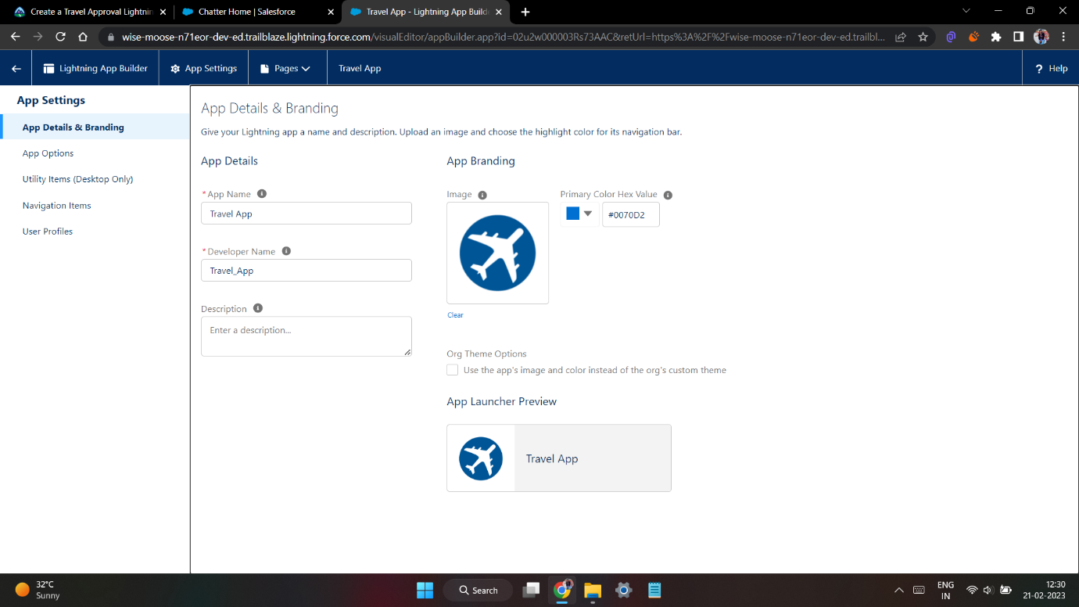
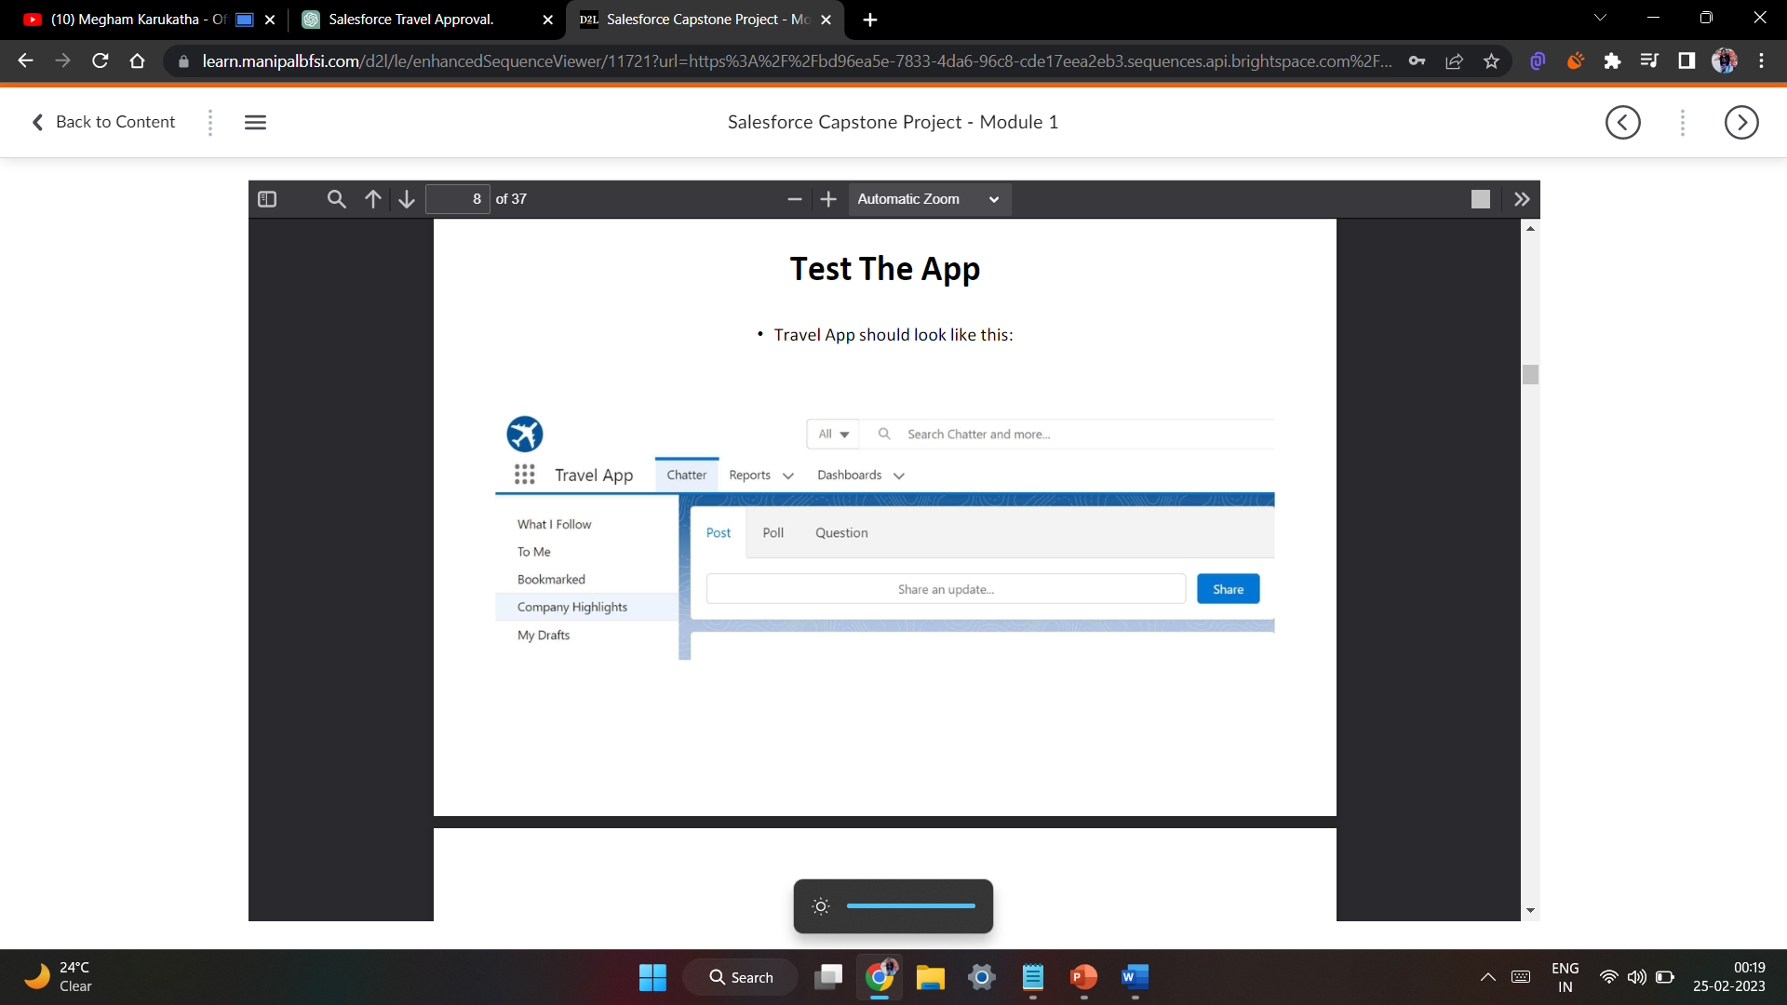
Creating Lightning App: TRAVEL APP

Slide 7
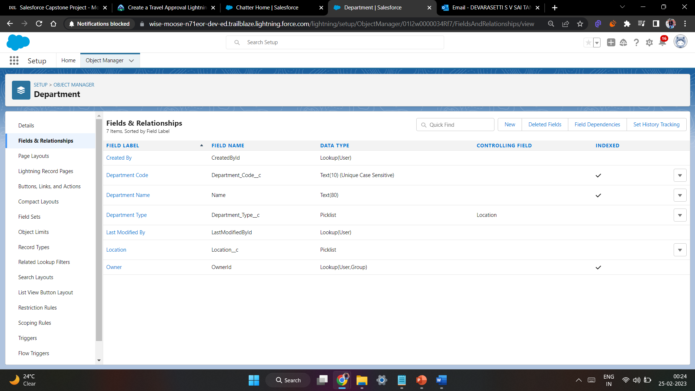
Custom object Department and Creating custom fields in Department object

Slide 8
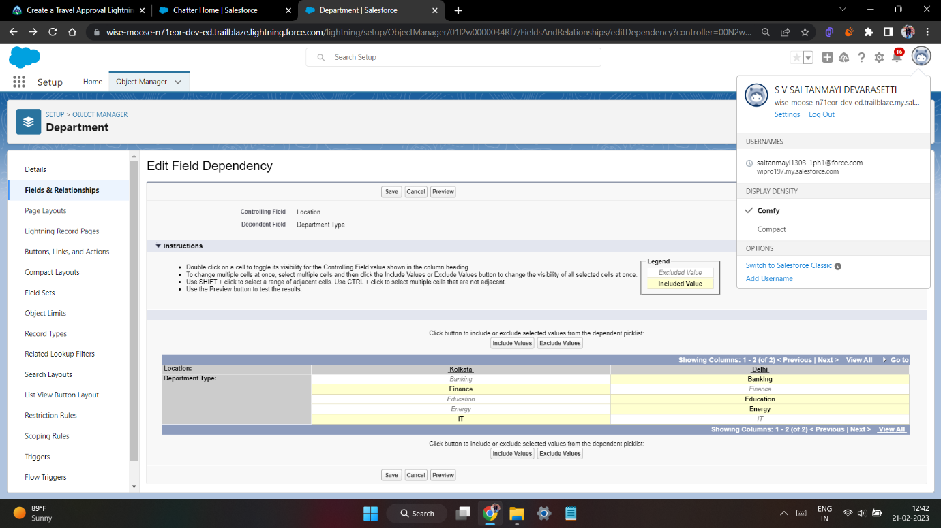
Field dependency in department

Slide 9
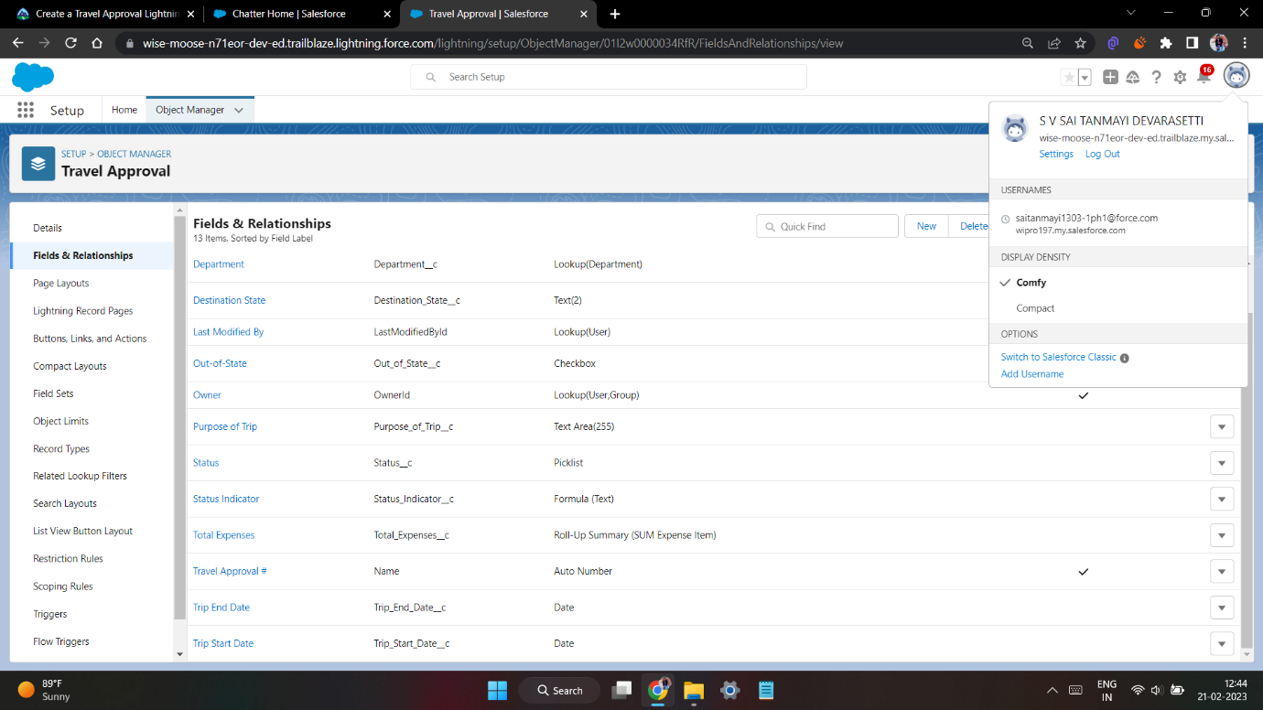
Creating Custom Object Travel Approval and Custom Fields in that Object

Slide 10
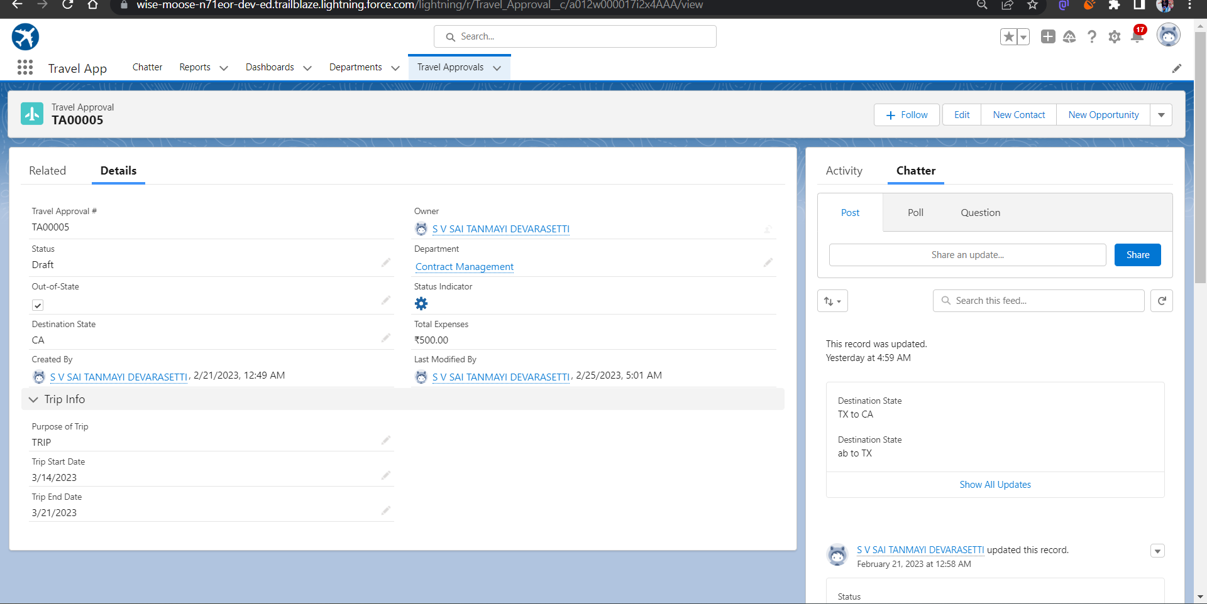
After creating travel approval object with fields, it looks as shown below

Slide 11
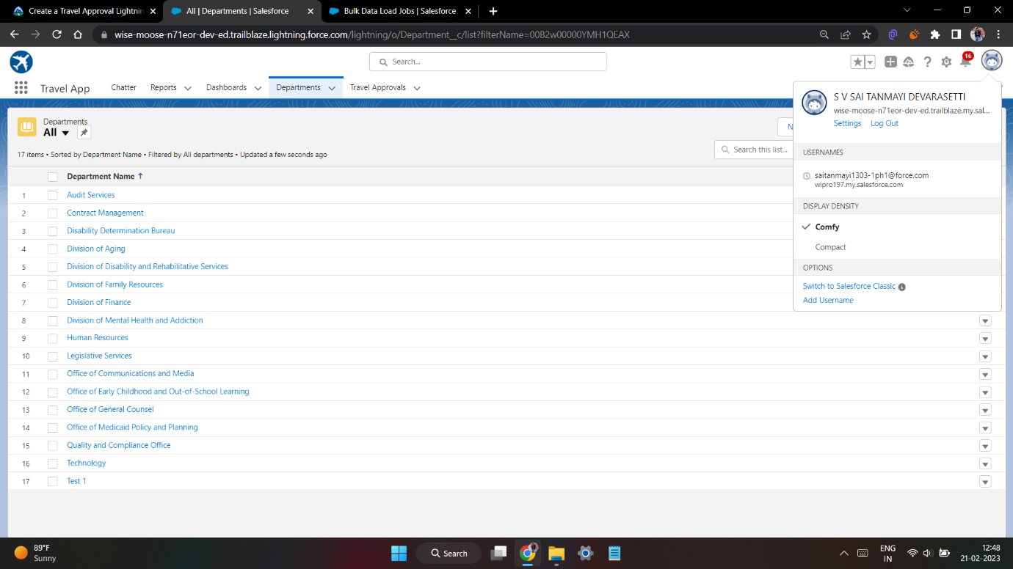
Importing Department records using data import wizard and imported record data status can viewed below

Slide 12
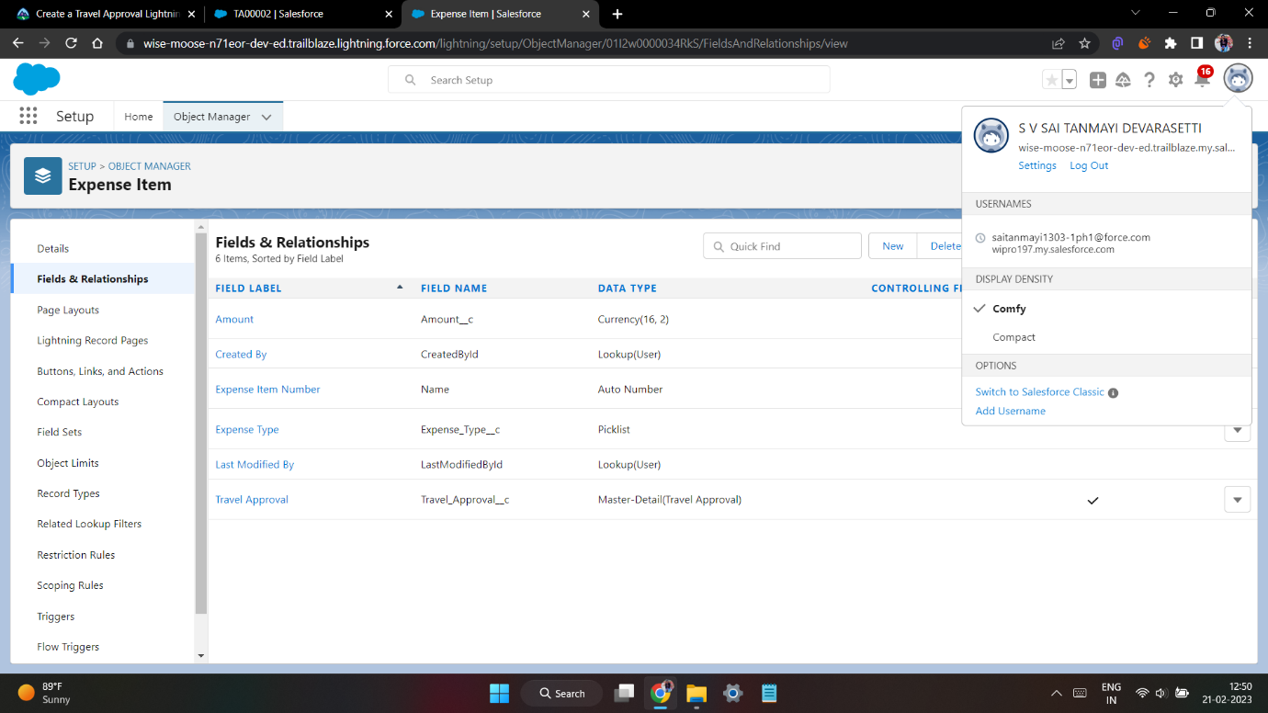
Creating Expense Item custom object and Custom fields in Expense Item object

Slide 13
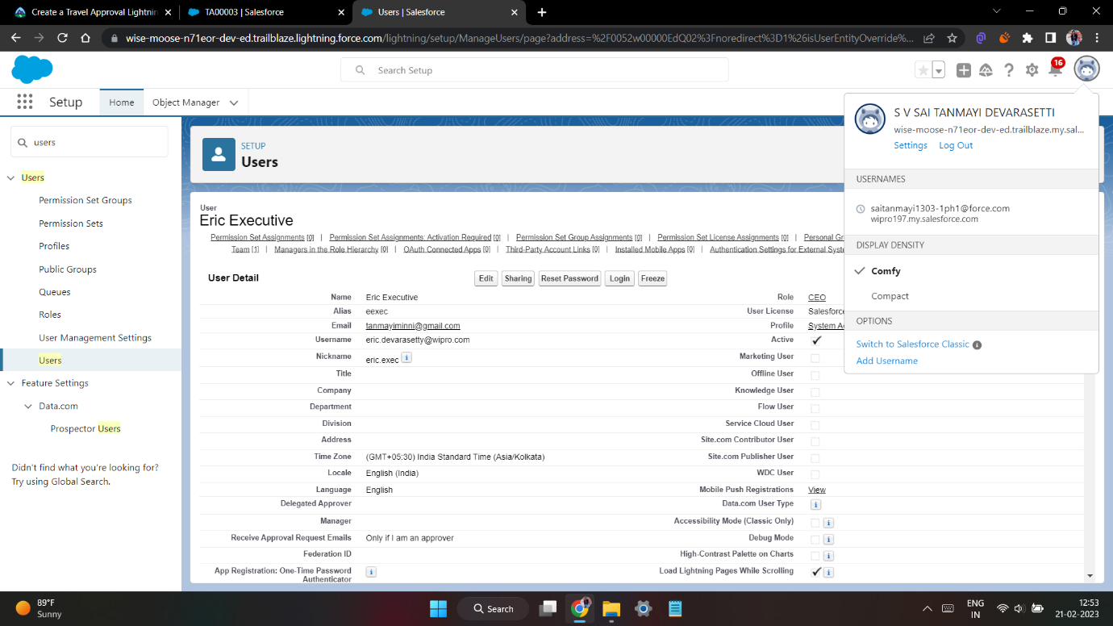
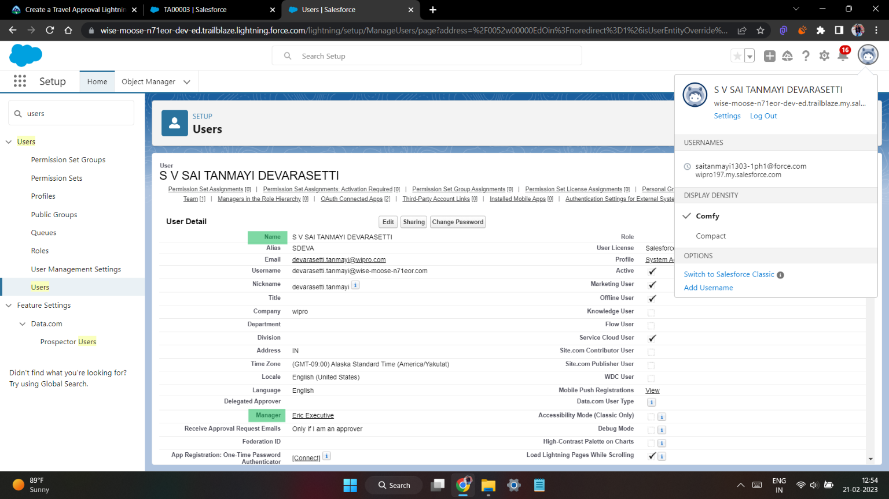
Creating User with
system admin license
Add user eric as
manager own account user

Slide 14
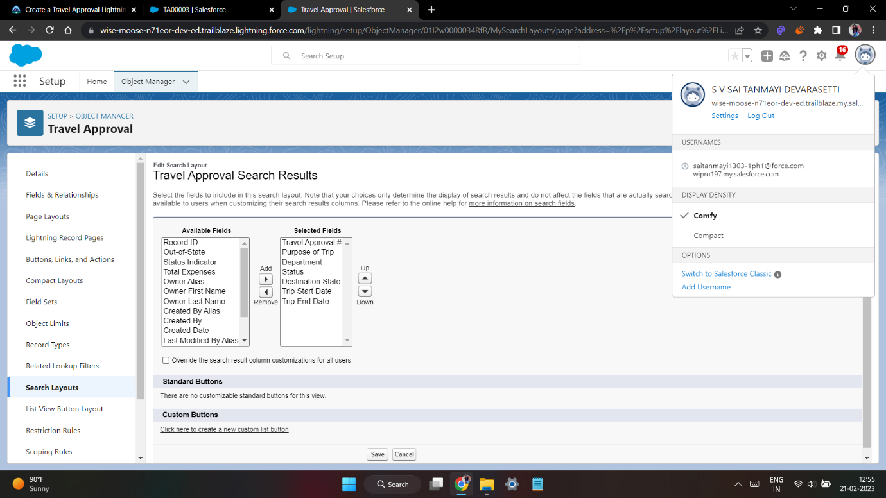
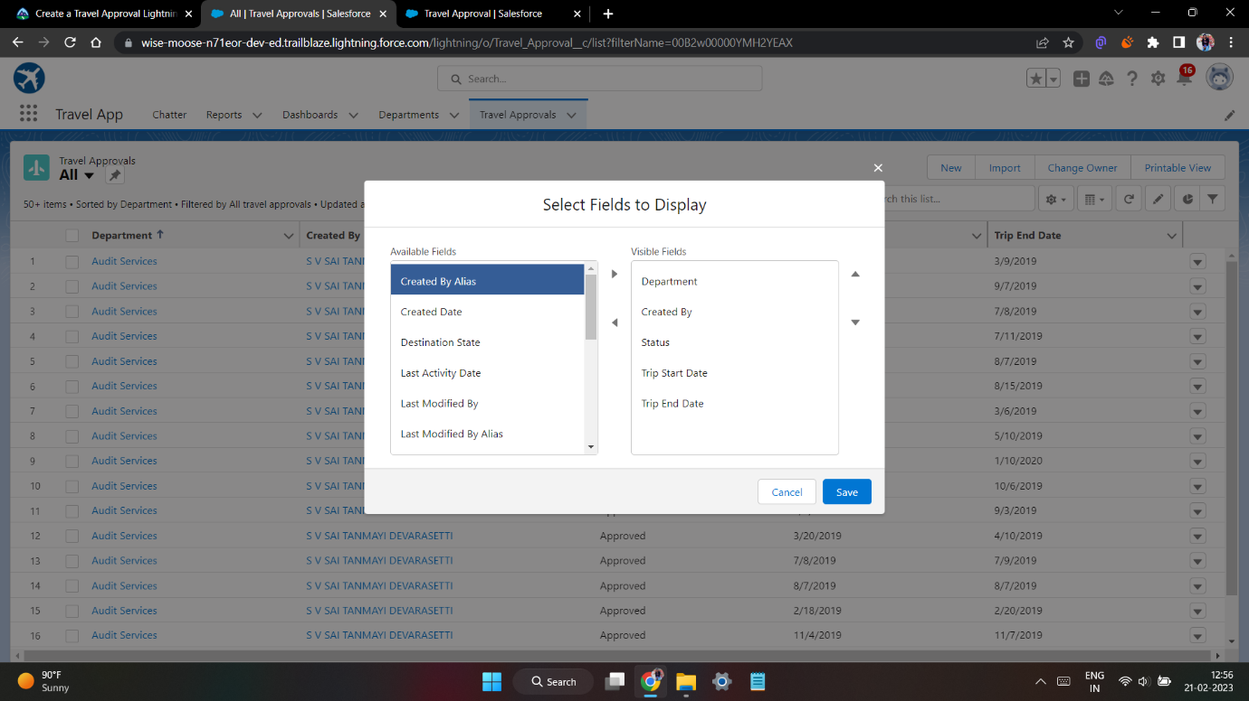
Customize the Travel Approval
Default search layout
Select fields to display in the Travel Approval “All” List view

Slide 15
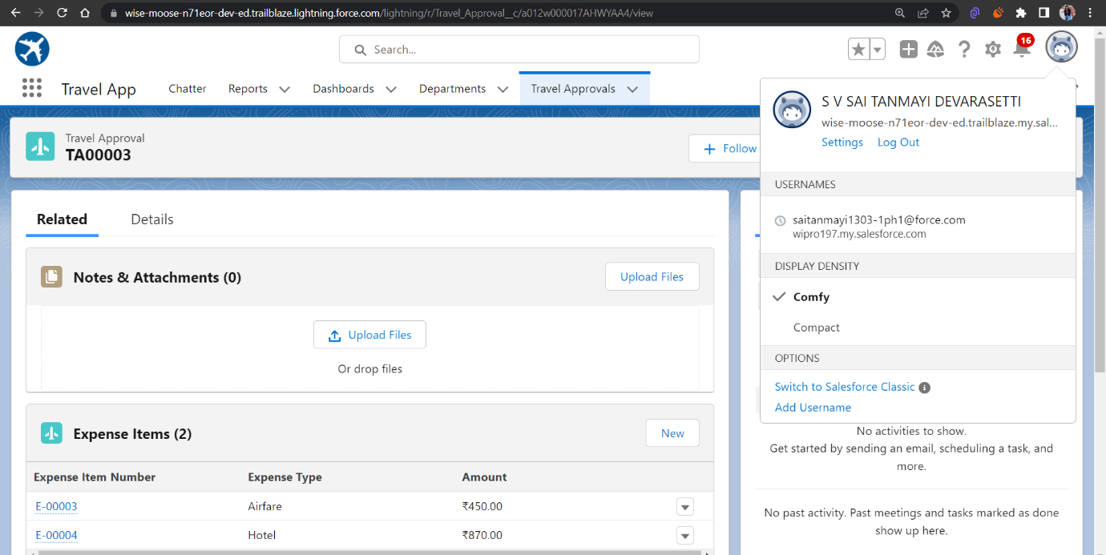
Customizing page layout

Slide 16
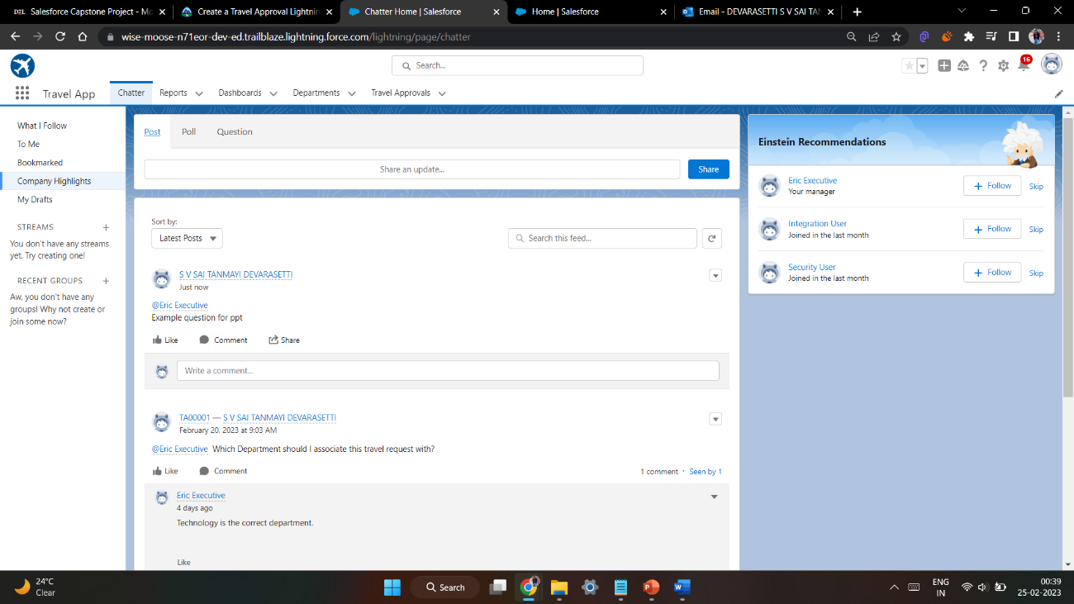
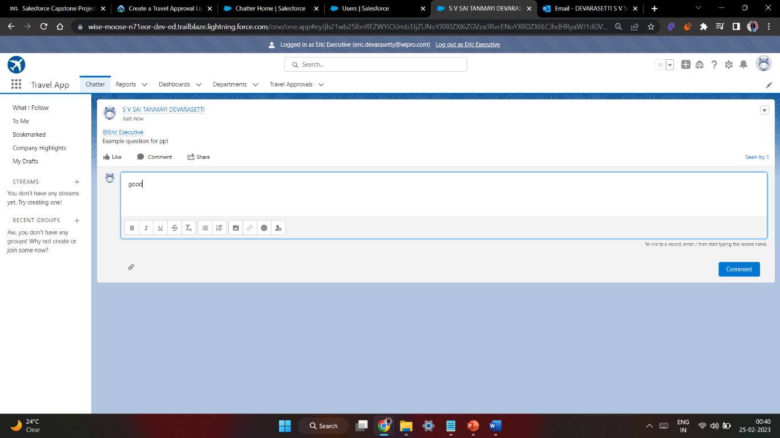
Test the app:

Slide 17
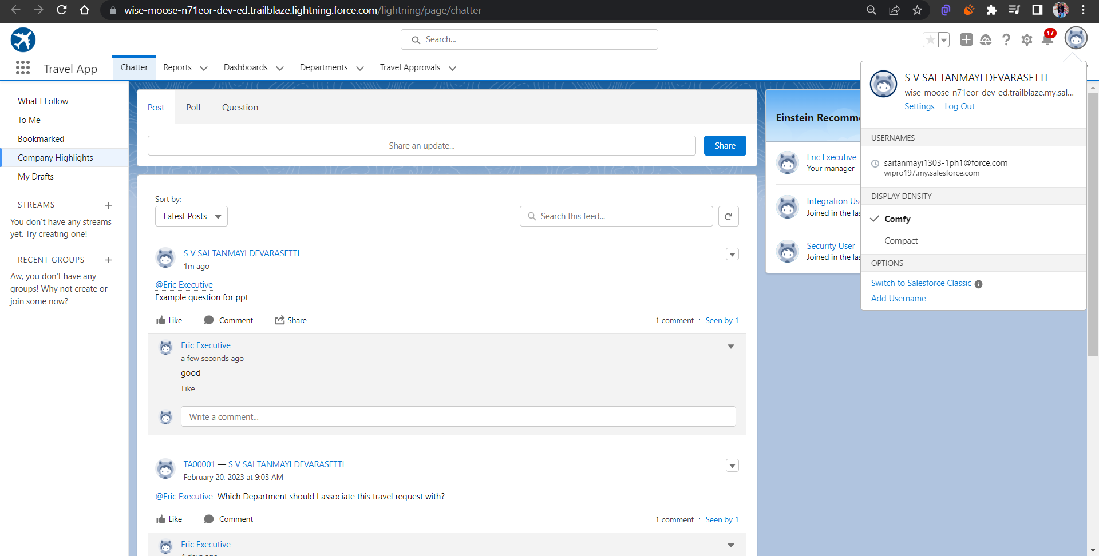

Slide 18
MODULE 2
This project module focuses on the Automation and Analytics Tools to enhance your custom App development.
Define Business logic using Validation rules, Roll-up summary fields, Formulas, Flows & how you track Travel Approvals using Reports and Dashboards
Module Take Away

Slide 19
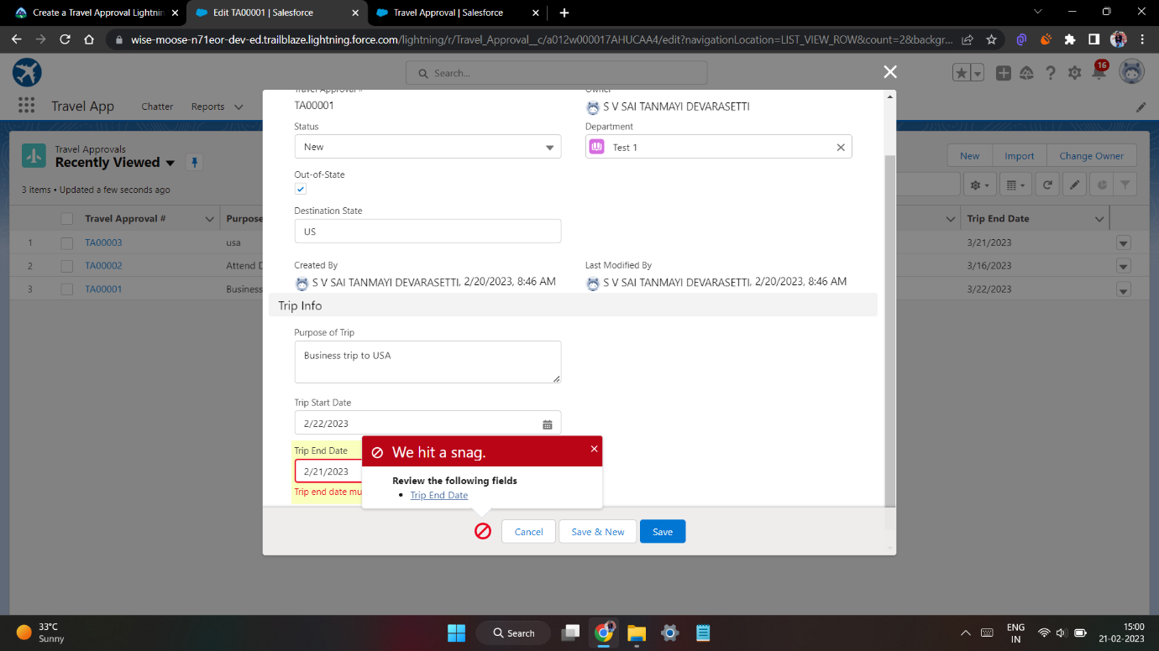
Validation Rule that trip end date always >= start date

Slide 20
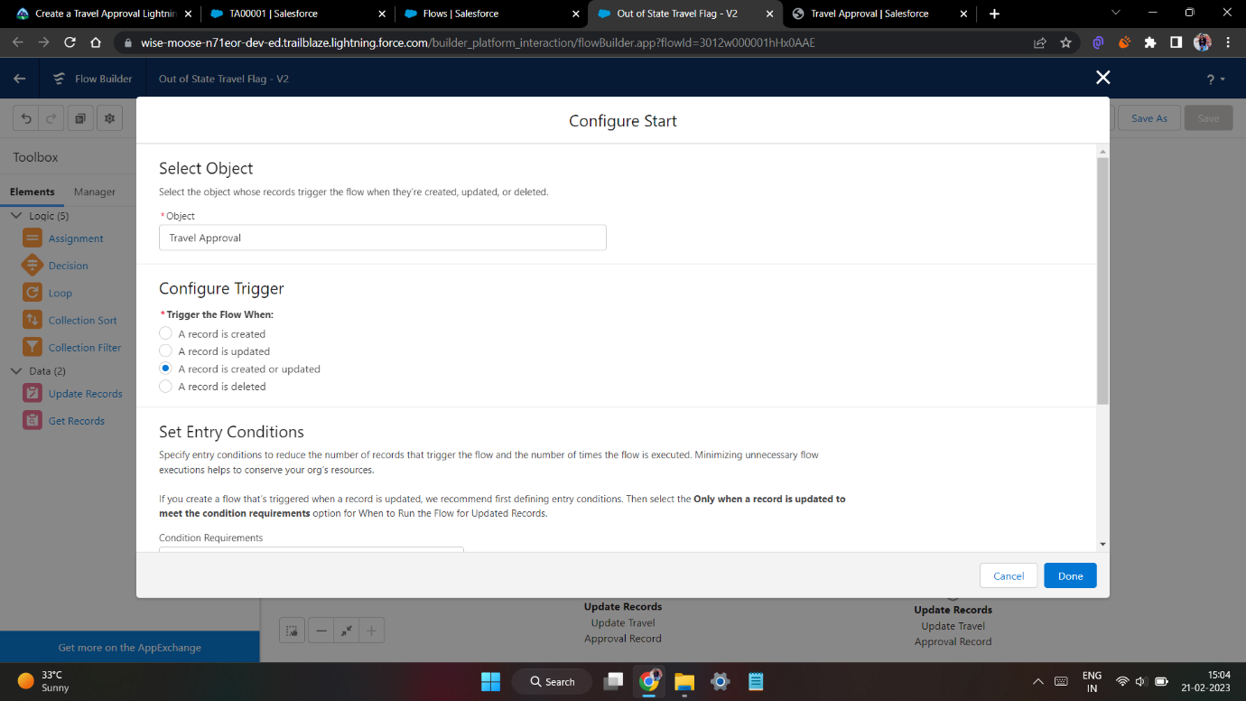
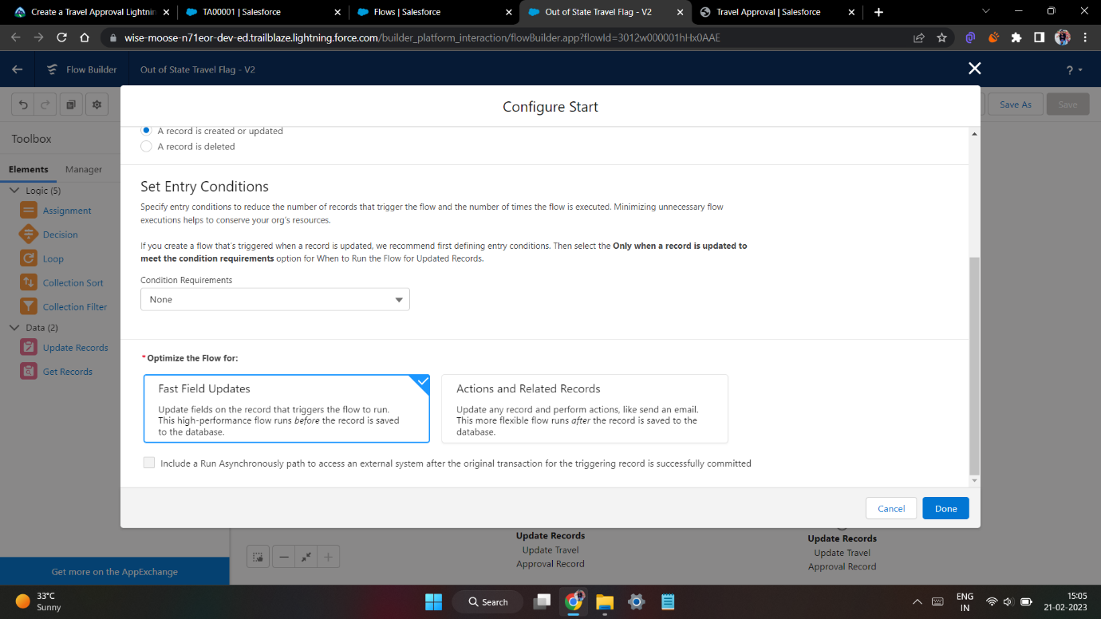
Create a Record – Triggered Flow

Slide 21
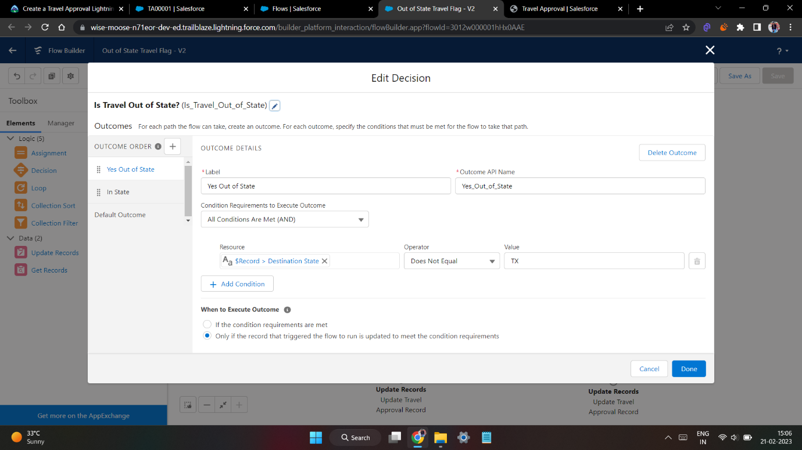
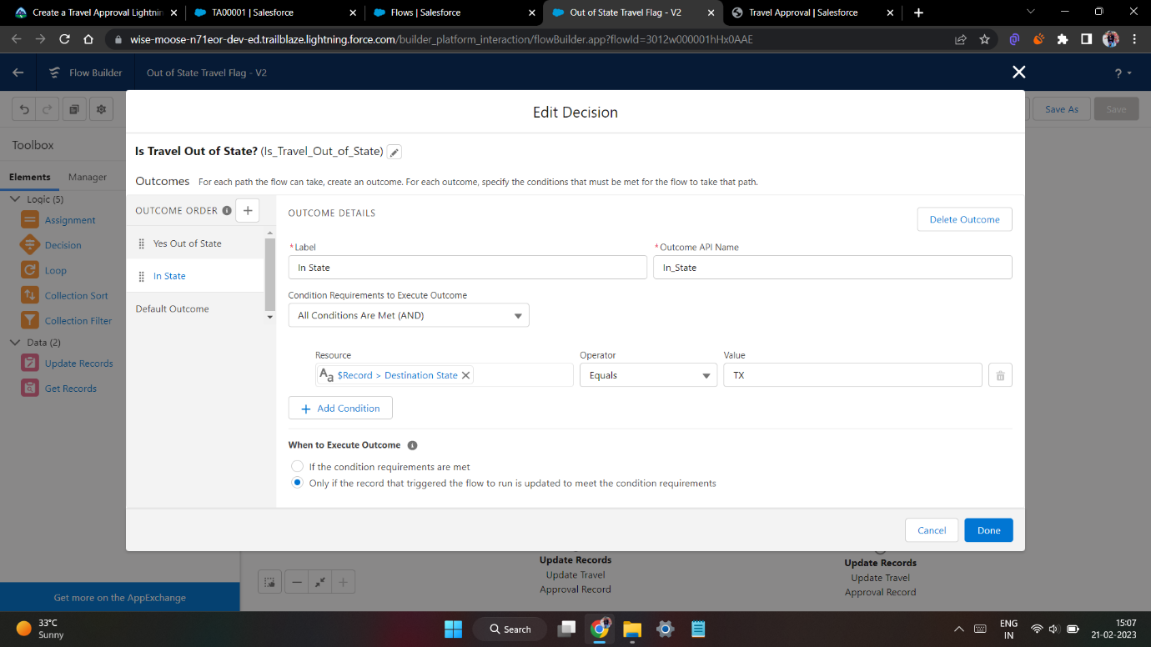
And add Decision element to flow

Slide 22
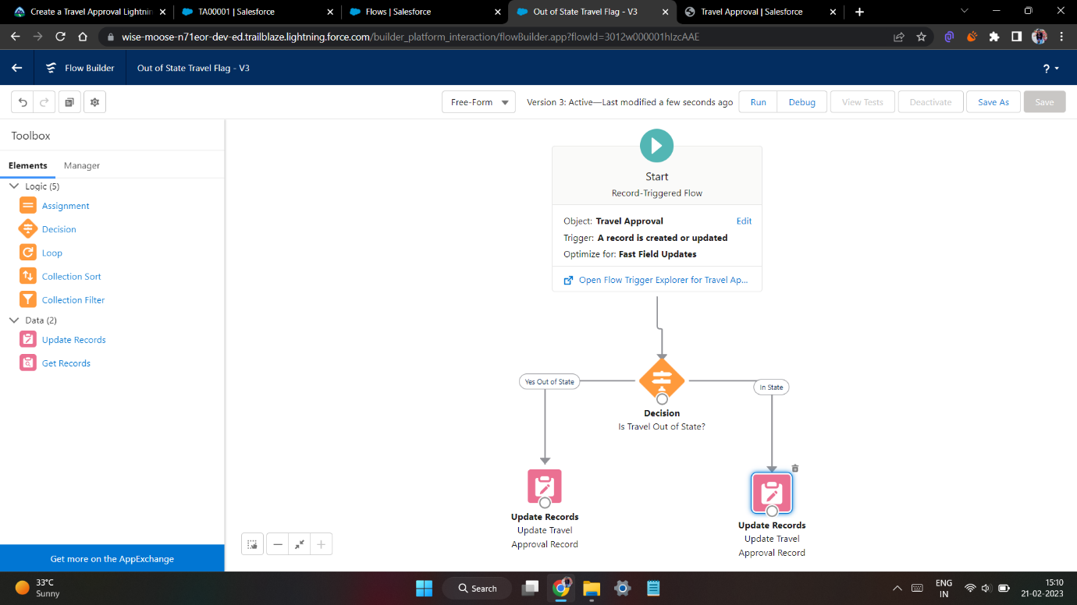
Finally, the flow looks as shown, save and activate

Slide 23
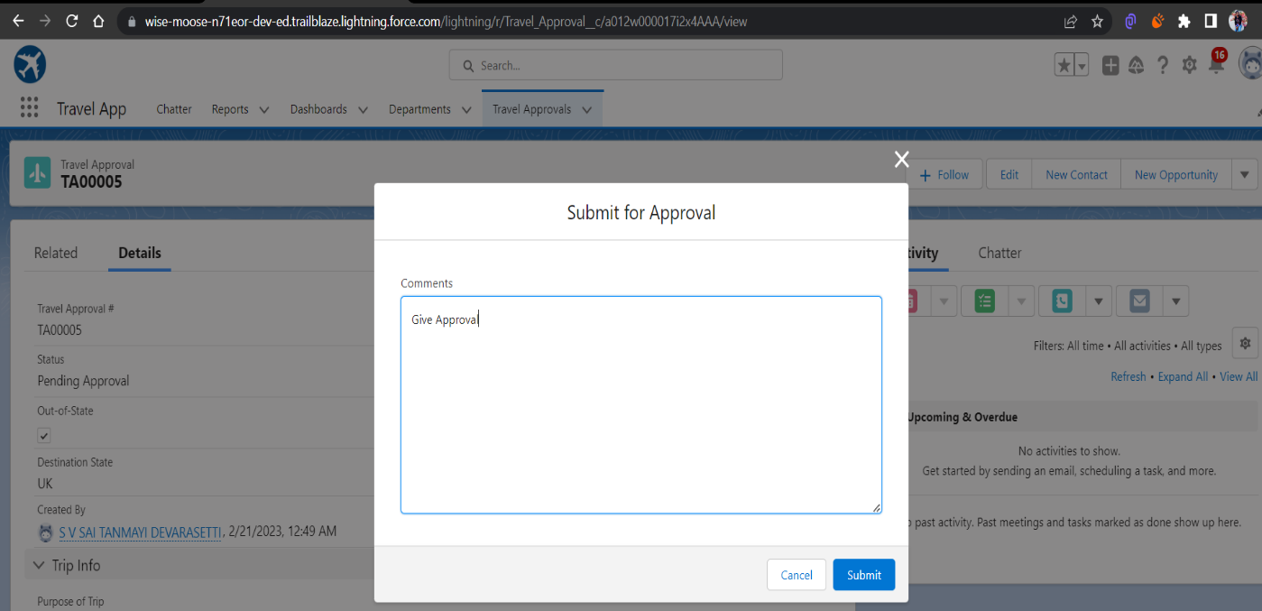
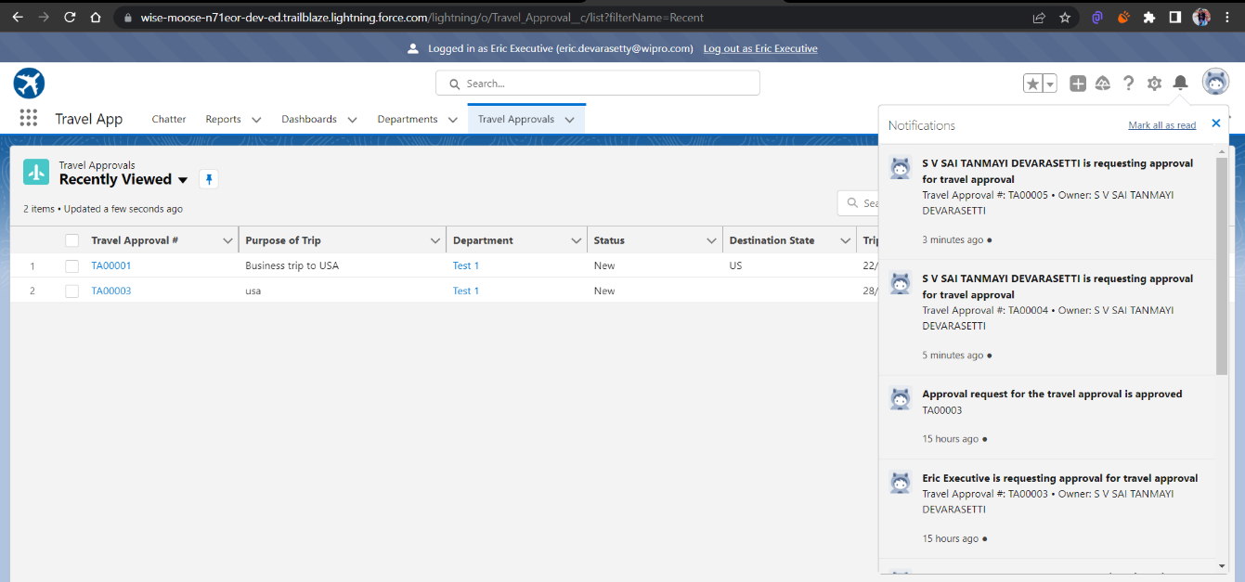
Testing the approval process

Slide 24
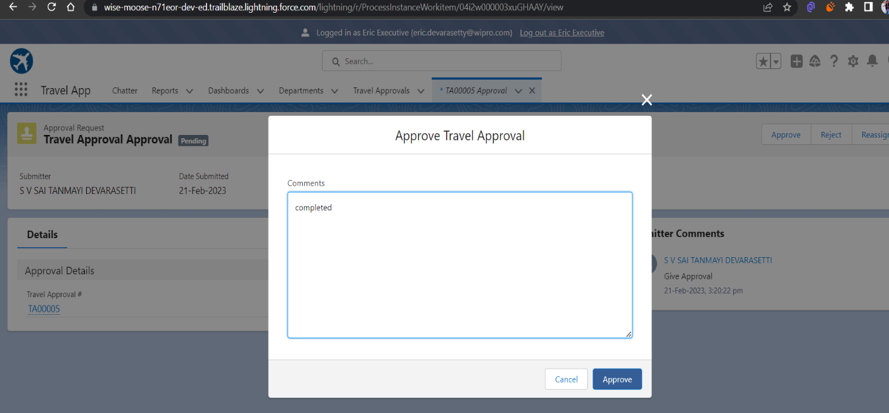
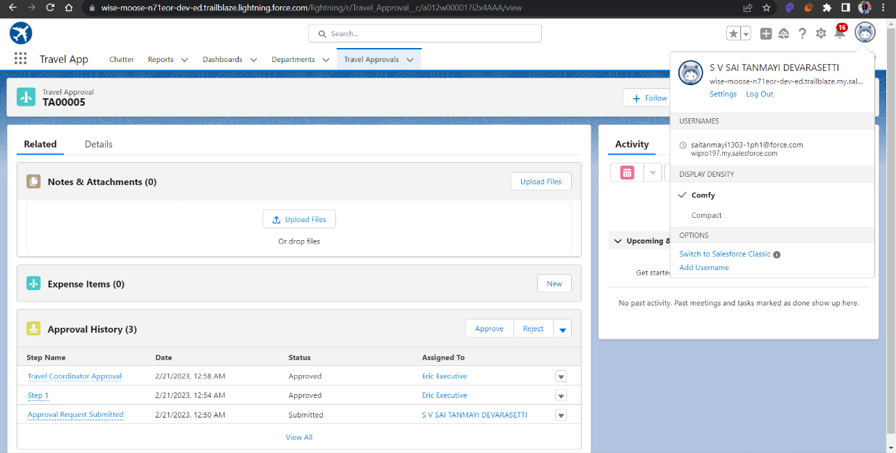
Login as Eric to give Approval Can Approve or Reject

Slide 25
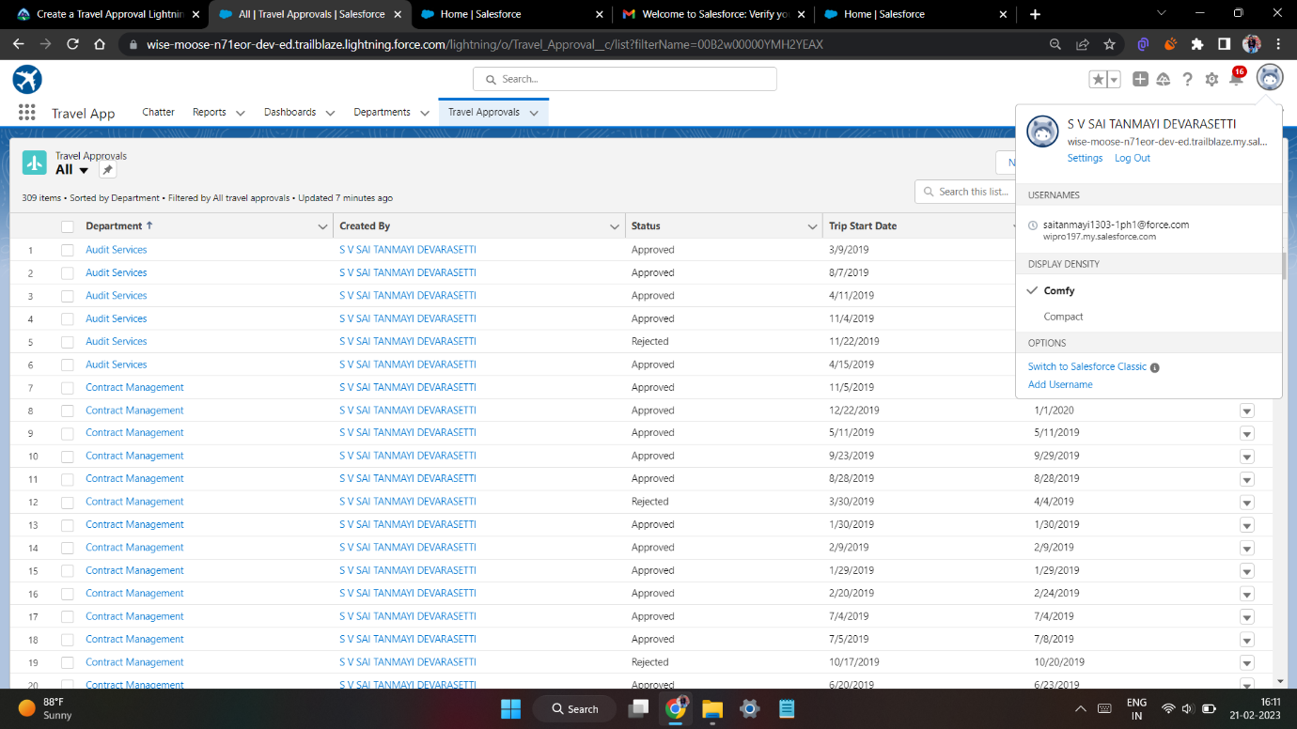
Using Data import wizard to import travel approval records , later the Records imported successfully

Slide 26
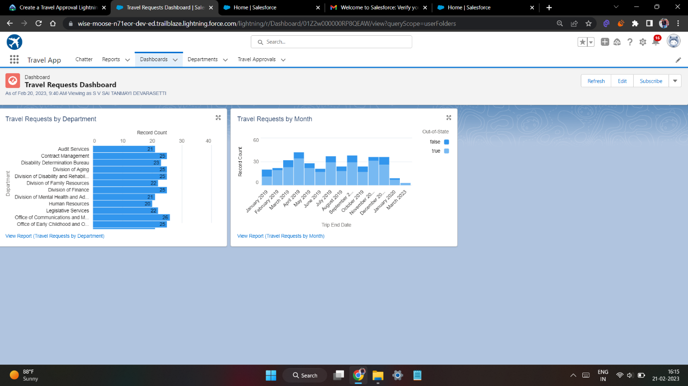
Final Dashboard

Slide 27
MODULE 3
This project module focuses on the coding approach to extend the functional capabilities of your custom App.

Slide 28
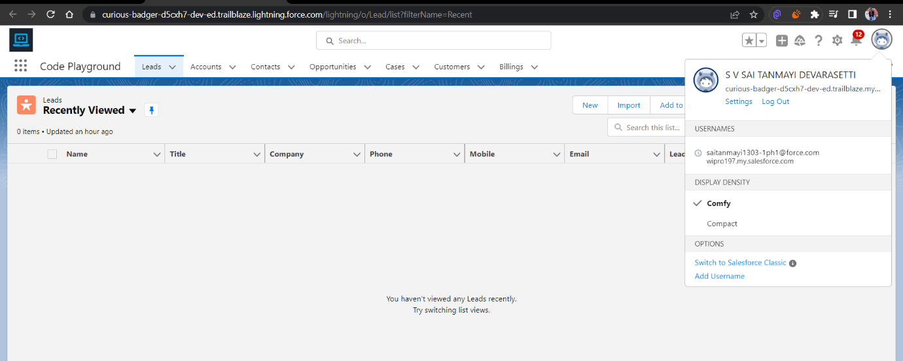
Exercise - 01 Creating Code Playground Lightning App with Lead, Account, Contact, Opportunity, Case to navigation profile as system admin.

Slide 29
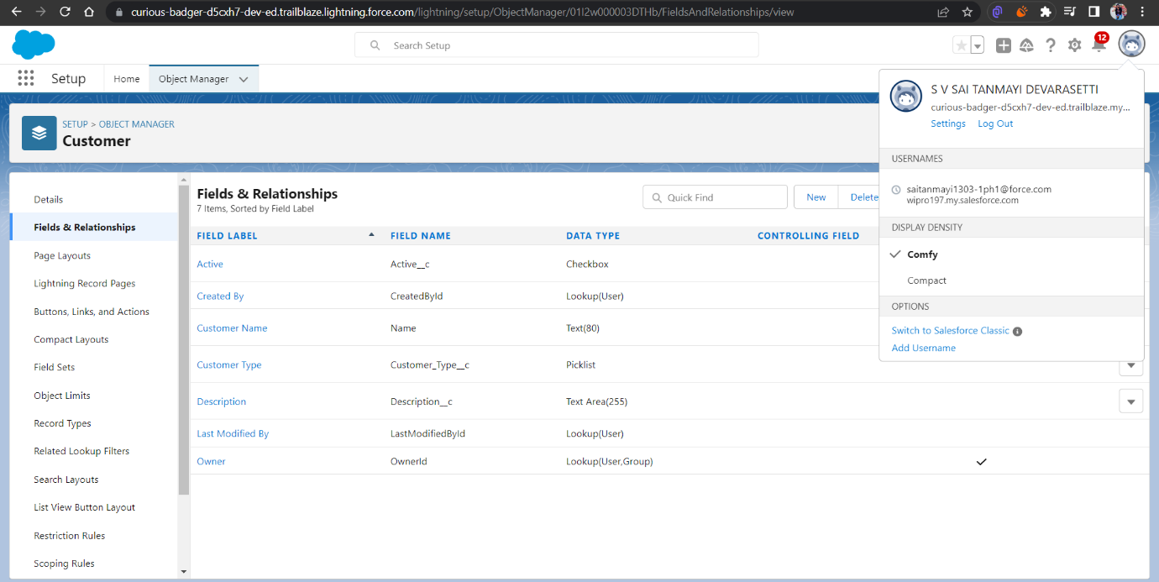
Creating custom object Customer and add related fields

Slide 30
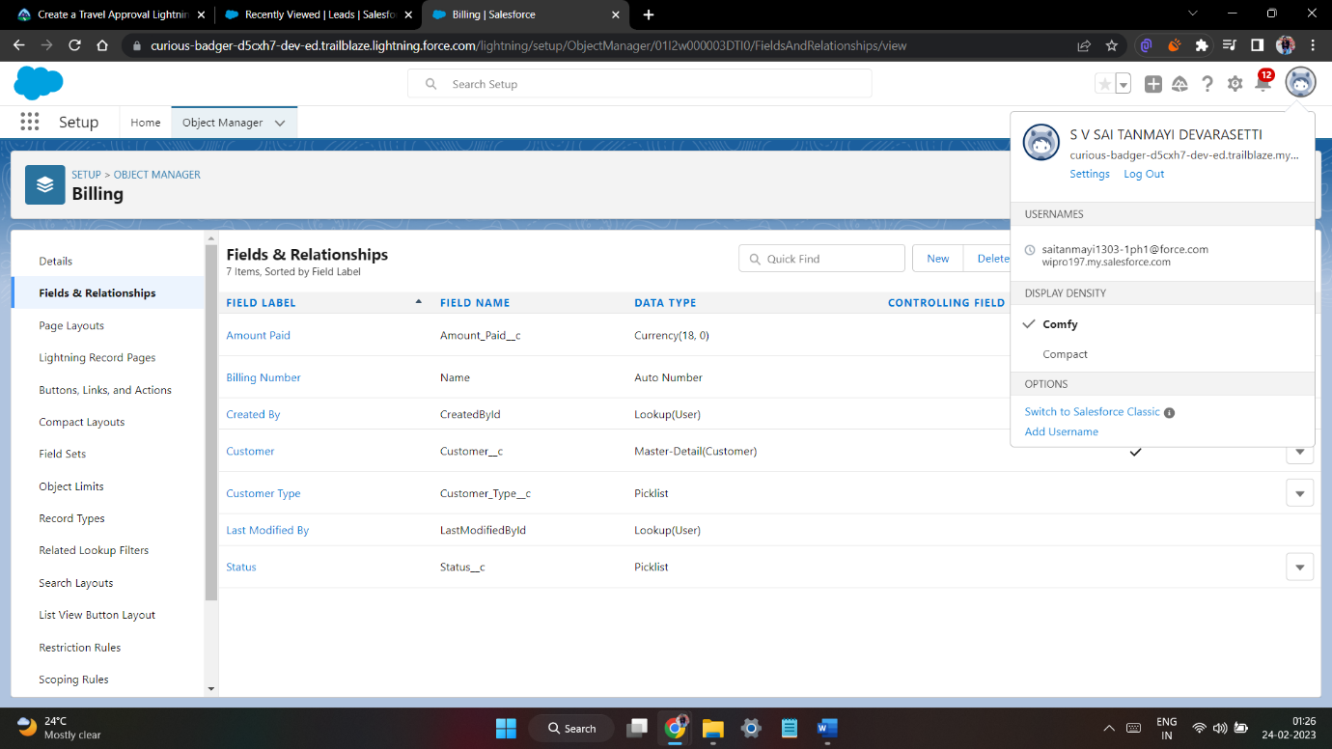
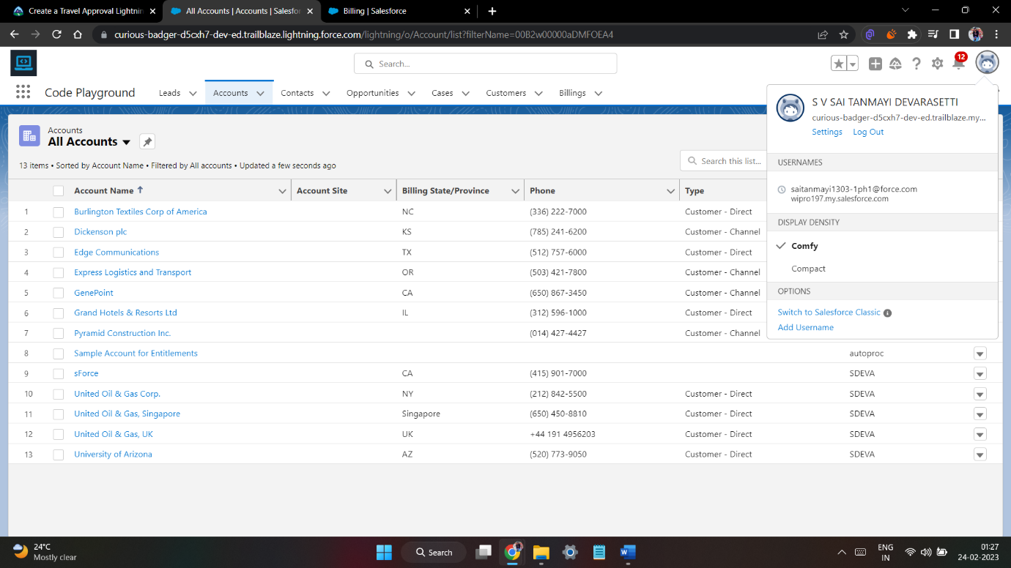
Creating custom object Billing and add related fields

Slide 31
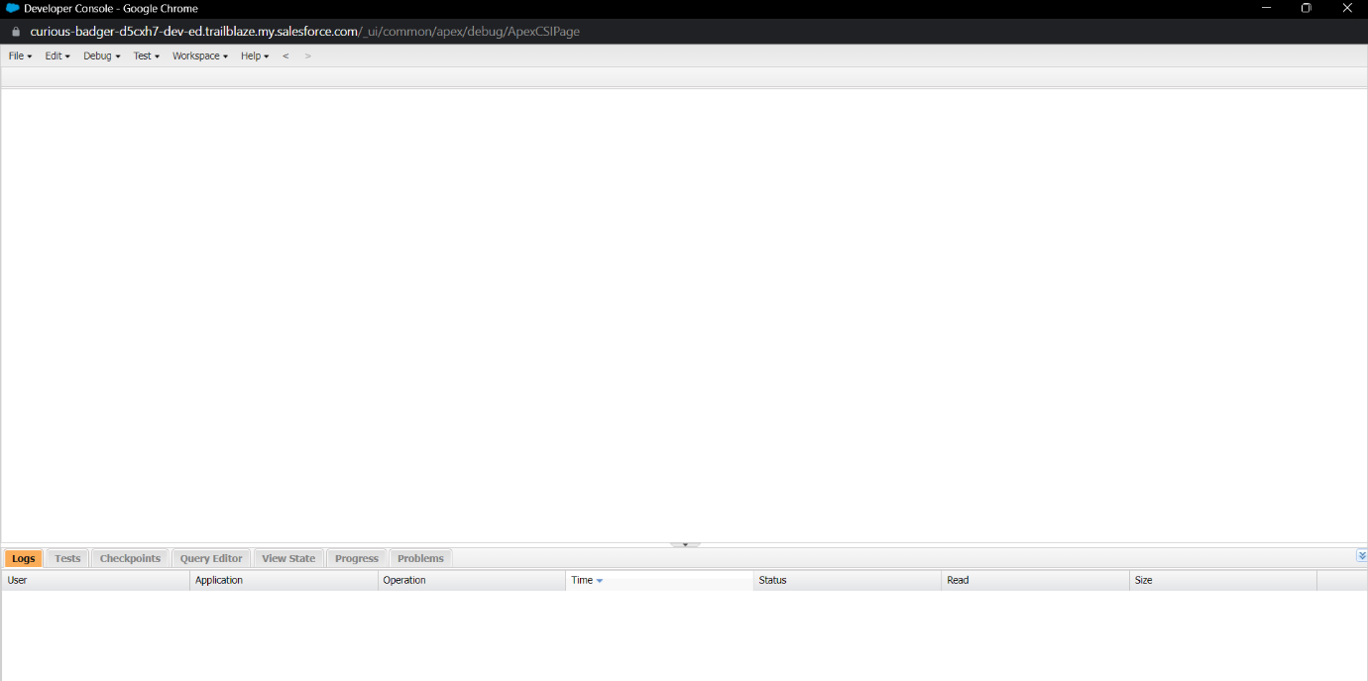
Exercise - 02 Use Execute Anonymous to define and execute the following code: Developer Console

Slide 32
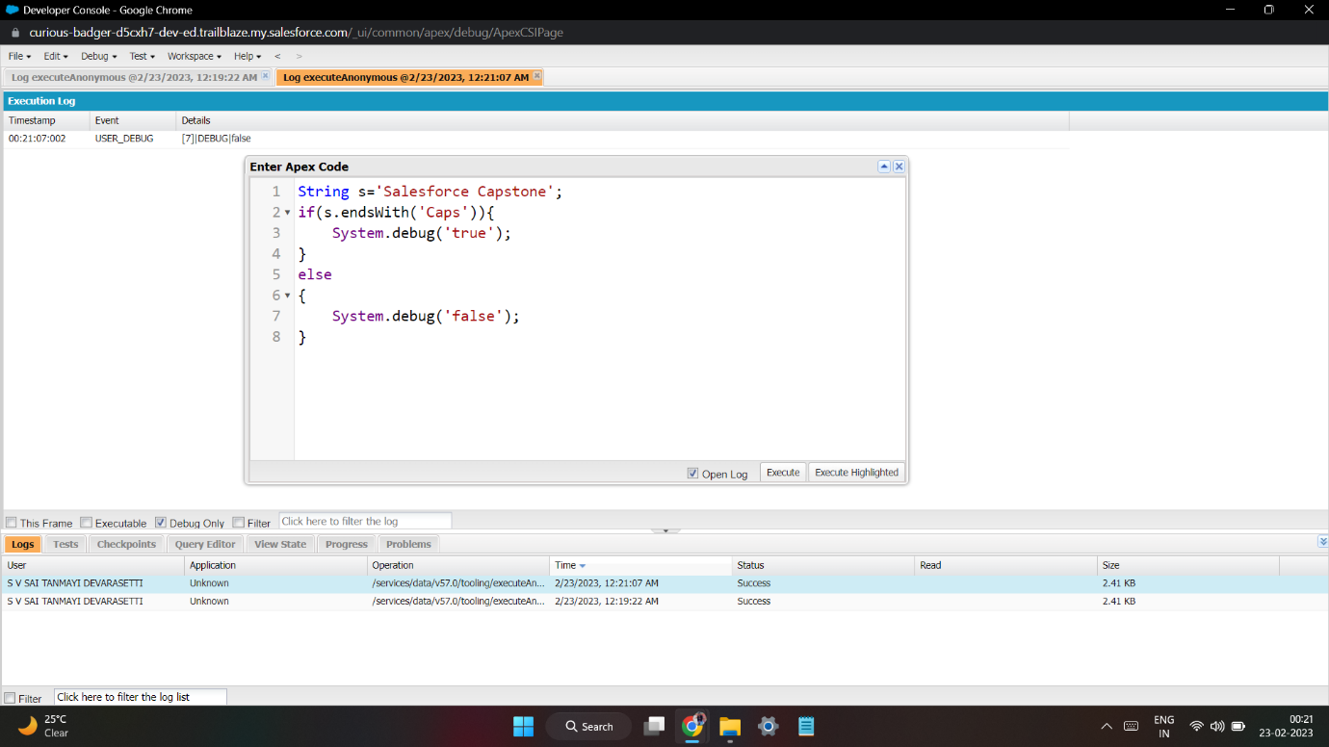
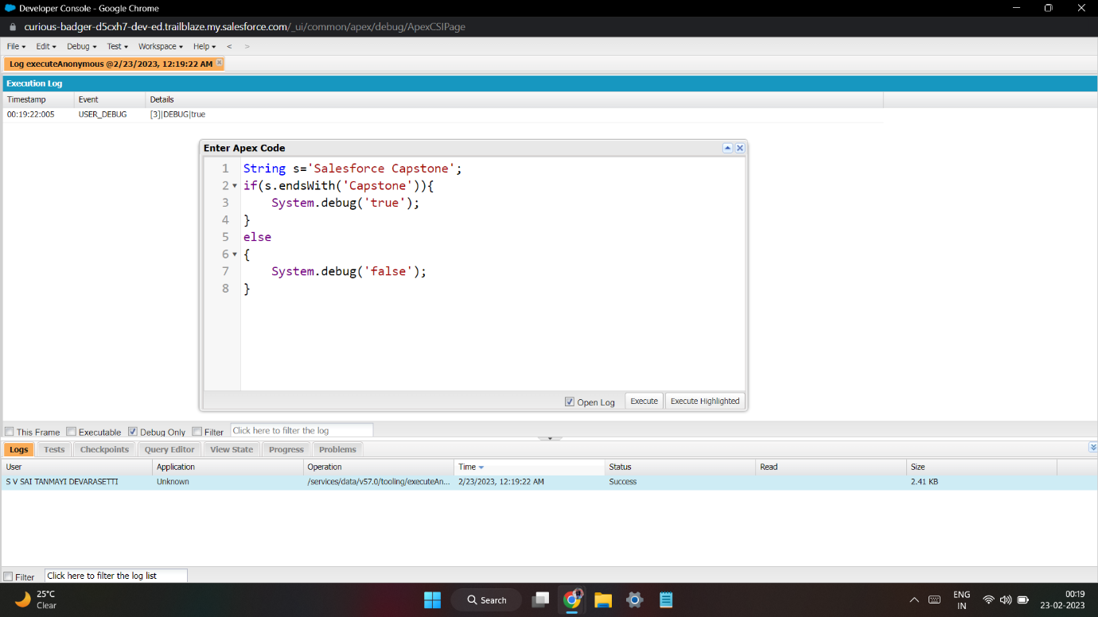
1.Define a String Variable & use string method ‘endsWith’ to display the output. By clicking oh Debug and select open Anonymous window

Slide 33
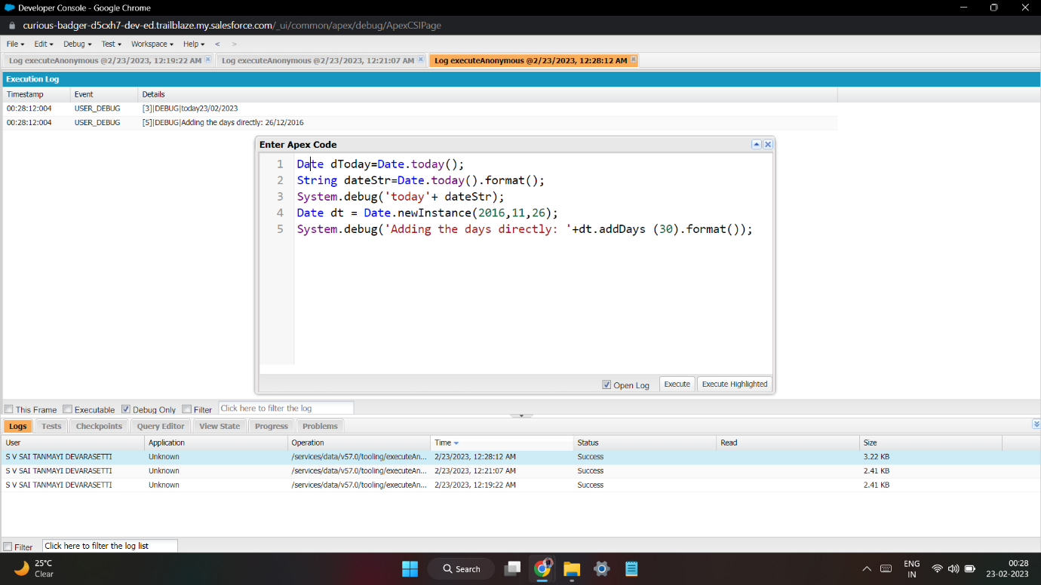
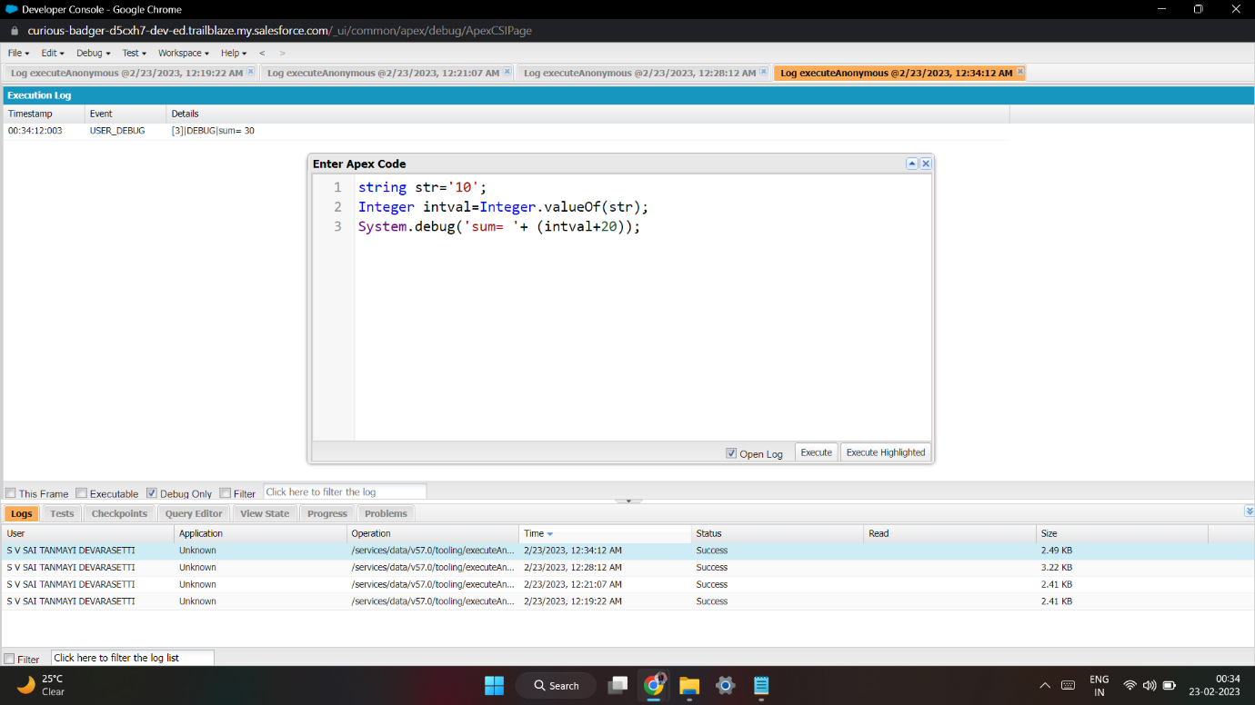
2. Define 2 Date type variables, use Date method today() & addDays(30) to display the output
3. Display the output of an Integer variable from string ‘10’ and then add 20 to it.

Slide 34
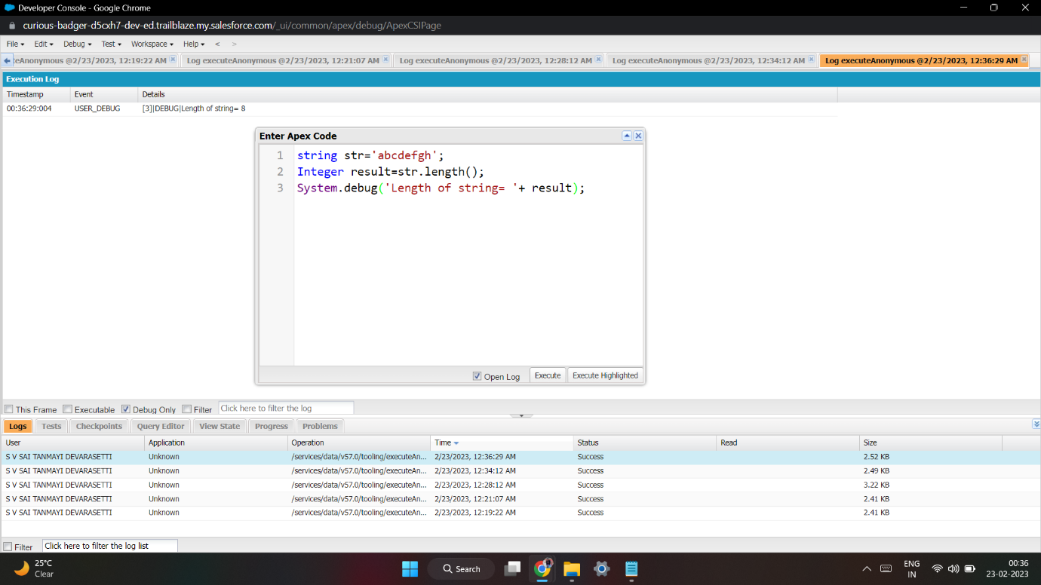
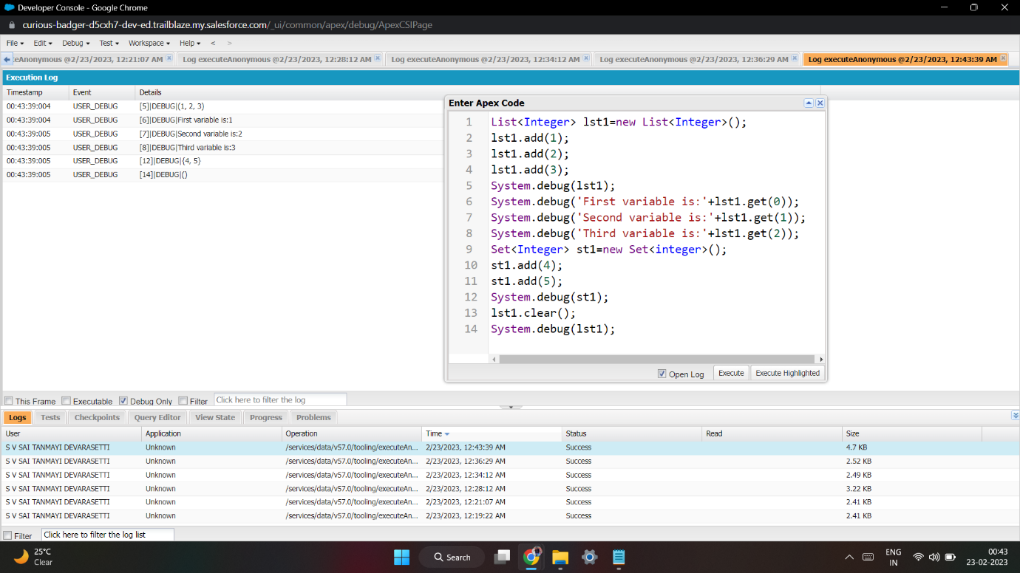
4. Define a String Variable & use string method length() to display the output
5. Define a List of integer and display the output using add(), get(), set(), clear(), methods.

Slide 35
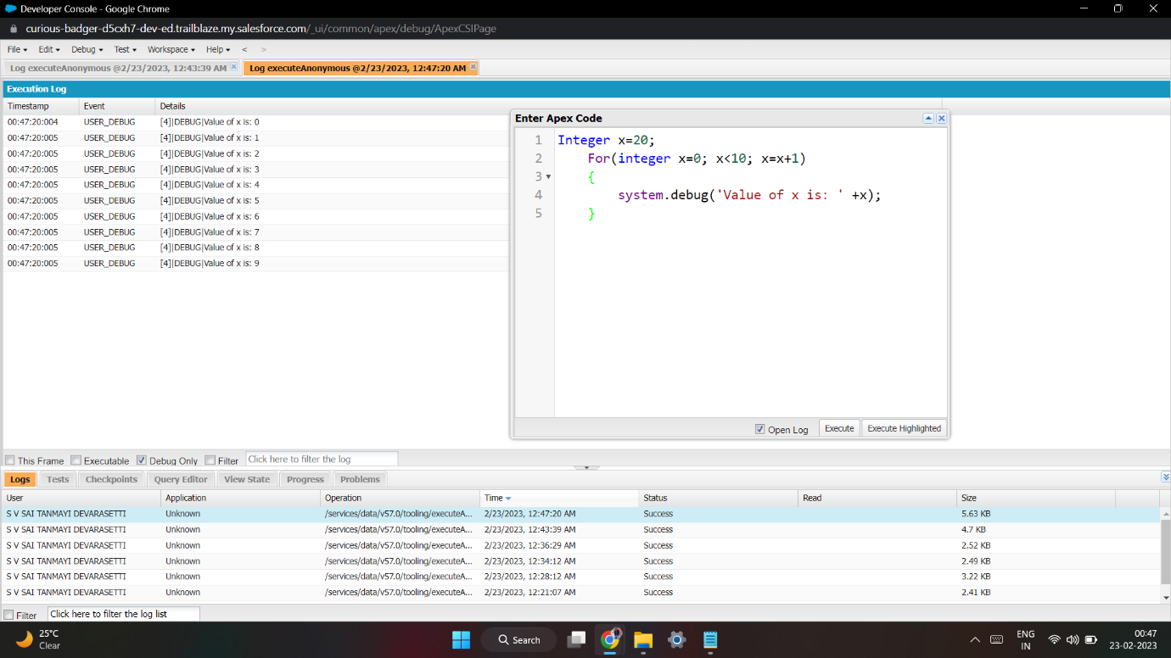
Use Execute Anonymous to define and execute the following code to display the value of x = 0 to 9.

Slide 36
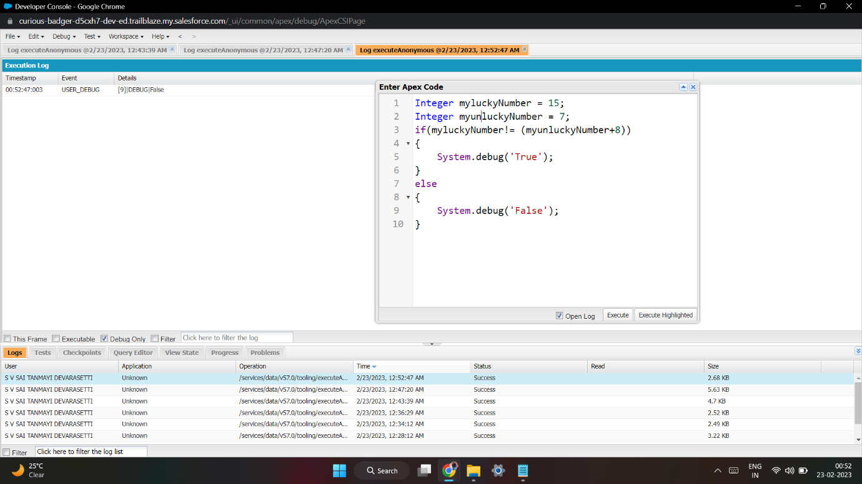
Exercise 3 Answer the following in True or False: Integer myunlucklyNumber = 7; Integer myluckyNumber = 15; myluckyNumber != myunlucklyNumber + 8.

Slide 37
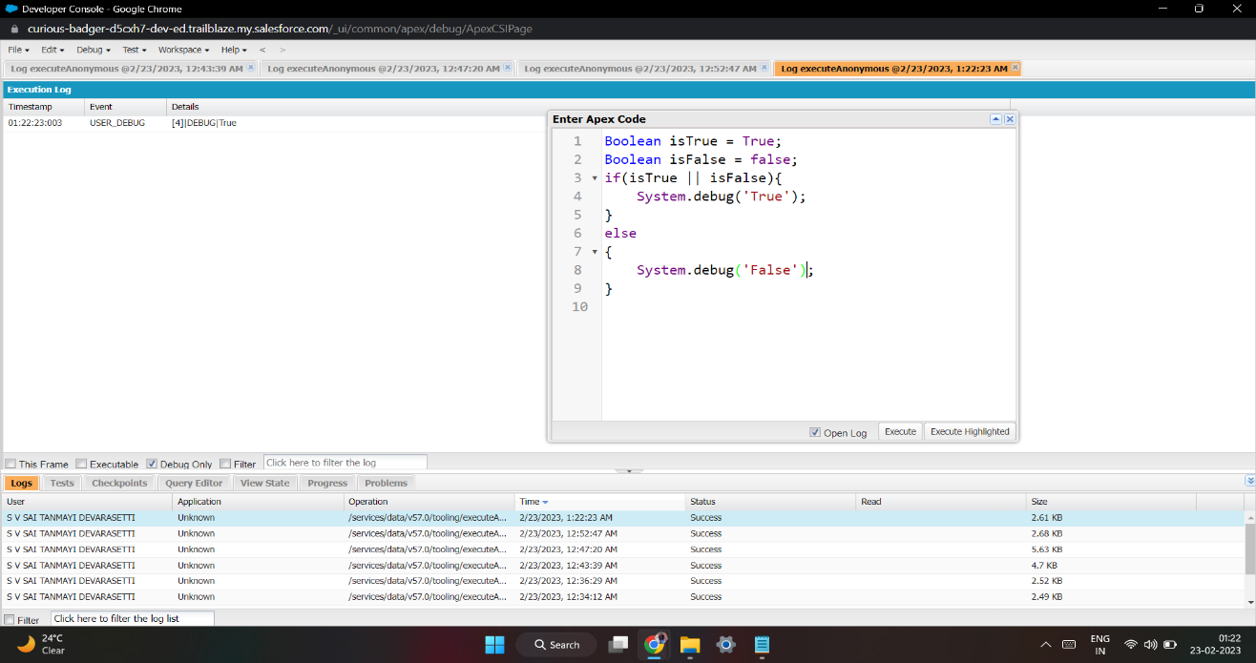
Exercise 4 Answer the following in True Or False: Boolean isFalse = false; Boolean isTrue = true; isTrue || isFalse

Slide 38
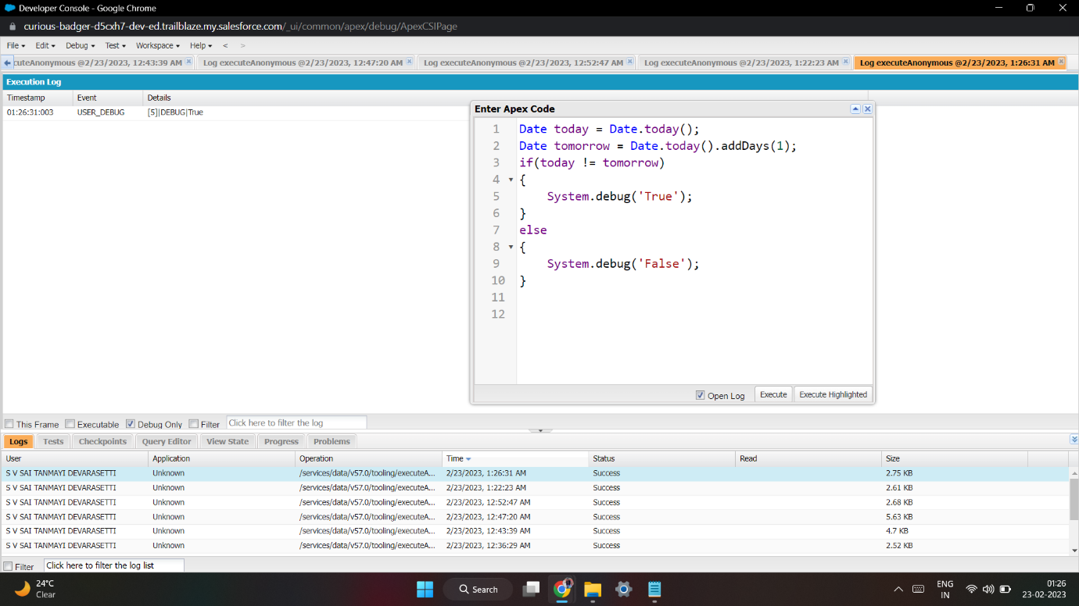
Exercise 5 Answer the following in True Or False: Date tomorrow = Date.today().addDays(1); Date today = Date.today(); today != tomorrow

Slide 39
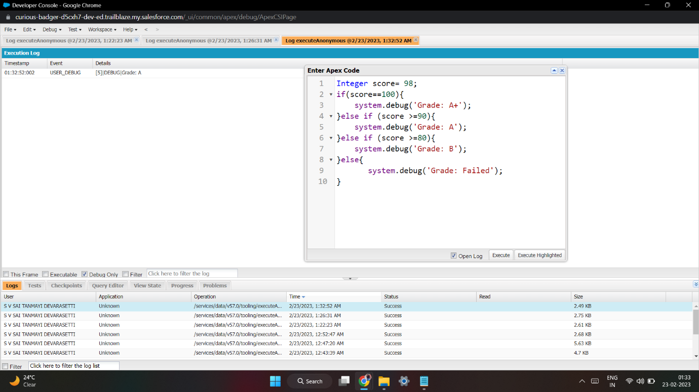
Exercise 6 Write a program and execute to demo the use of “If..else if...else”

Slide 40
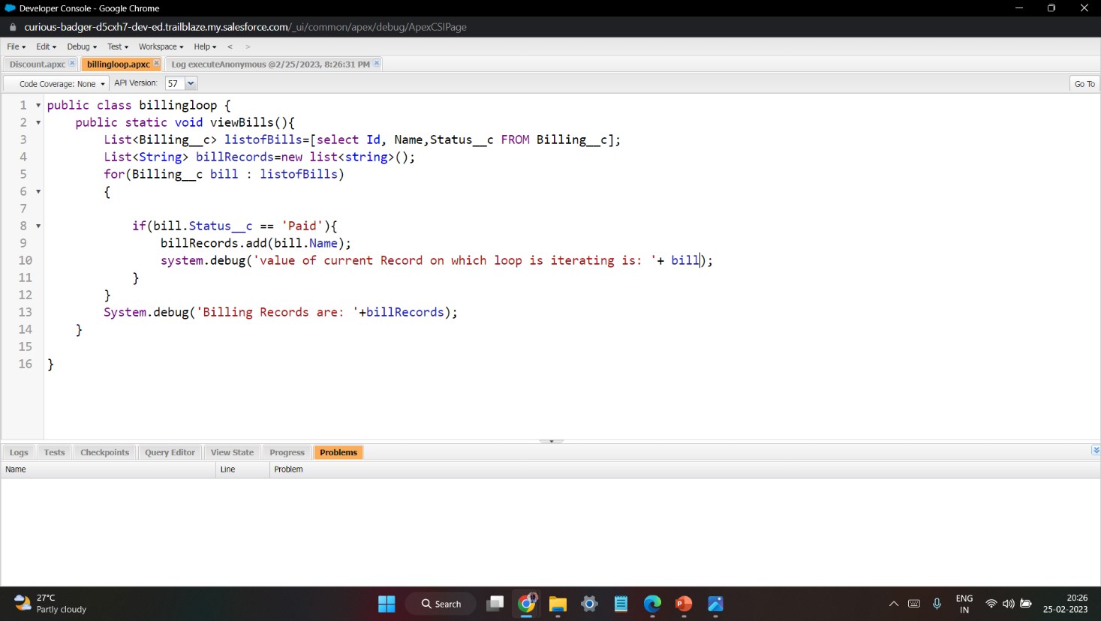
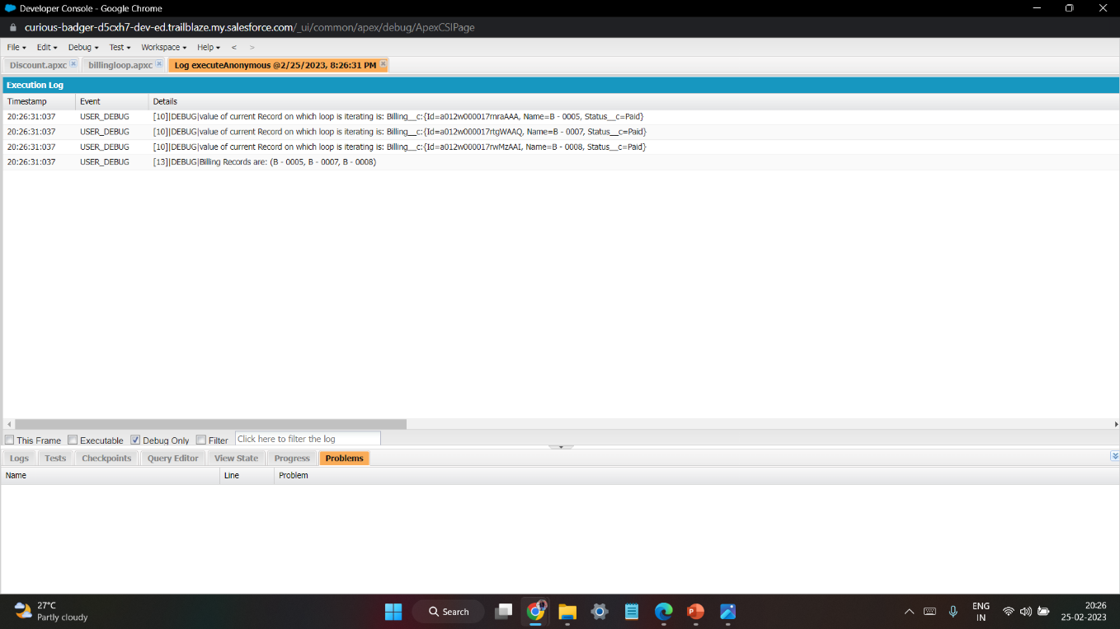
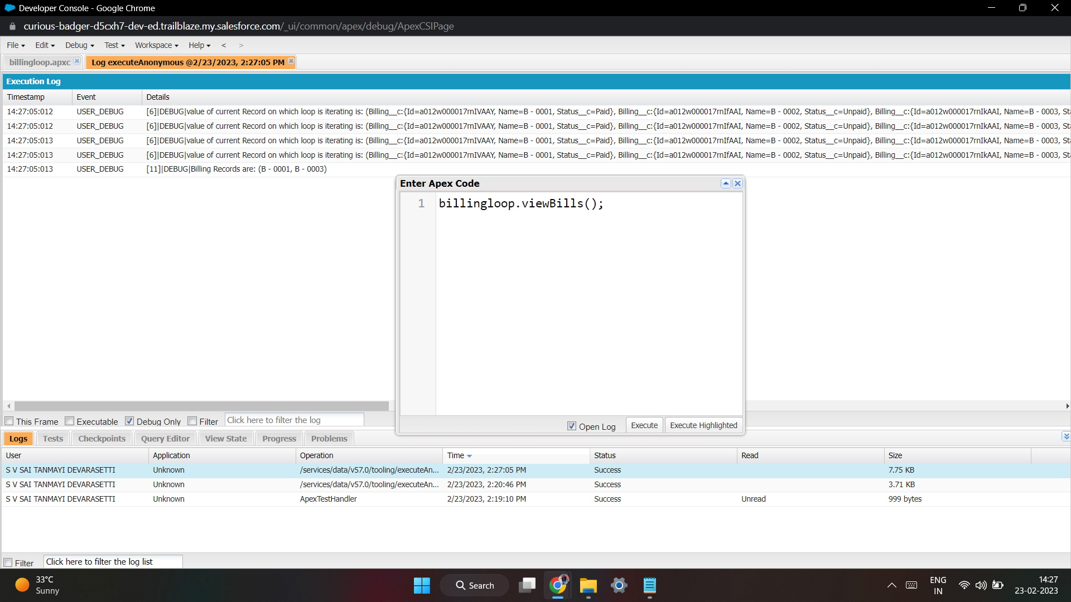
Exercise 7 Write a program to execute and demo the use of “Apex – for Loop” Initialize the Billing object list to store the Billing Records created today, use SQOL.. Use for Loop to iterate over the list and check if the Billings status = Paid System.debug (‘Value of Current Record in the Loop’+ Billing List); if Status is paid then add the Billings into a List of String. System.debug('Value of BillingList '+BillingList);

Slide 41
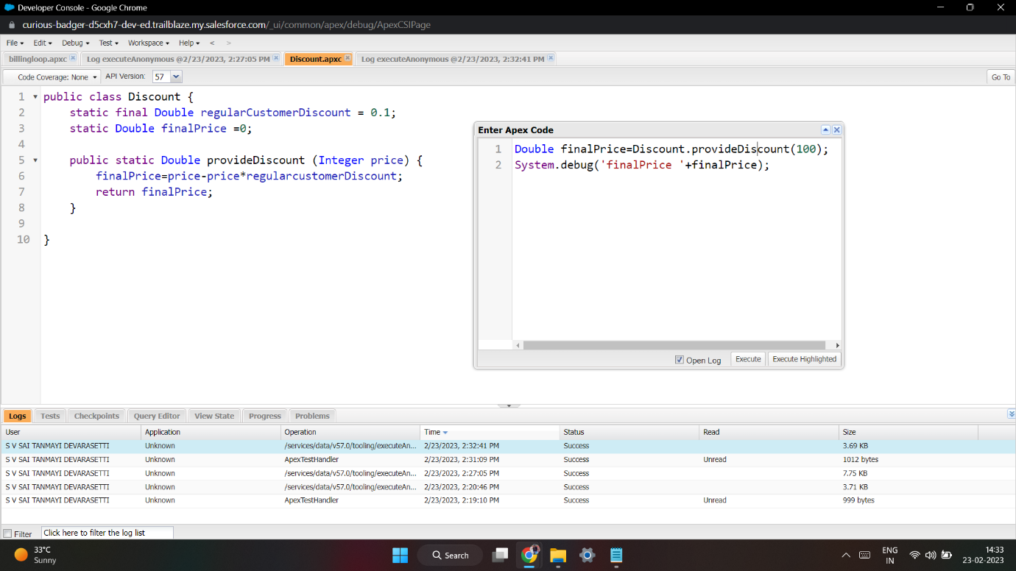
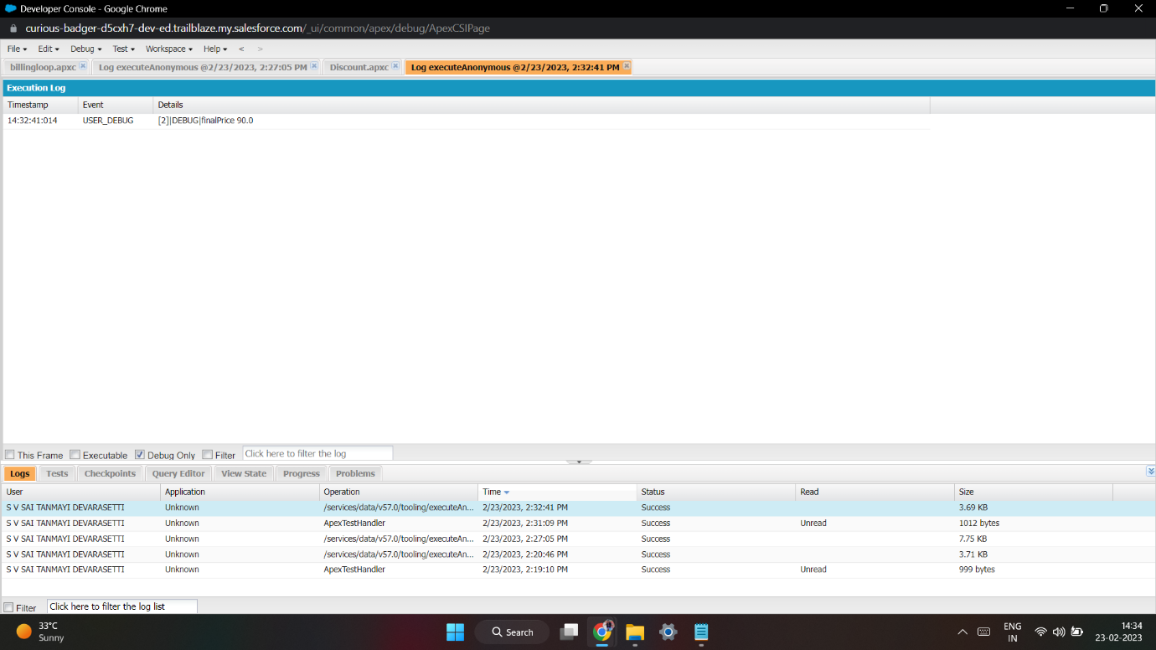
Exercise 8 Write a Class to demo the use of Constants in Apex Define a Method called “calculateDiscount(Integer price)”, takes a Decimal data type. finalPrice = price - price*regularDiscount;

Slide 42
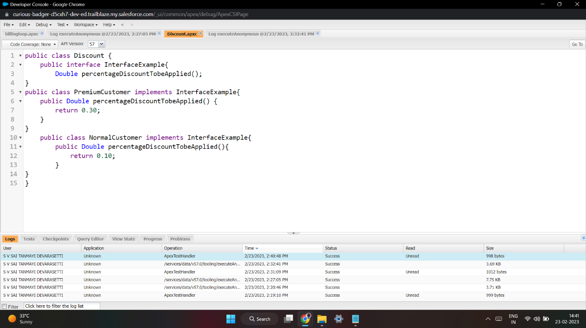
Exercise 9 Write a Class to demo the use of Interface in Apex Method Signature = Double percentageDiscountTobeApplied(); Create an Apex Class to implement the Interface Class, Name = PremiumCustomer Call the interface method to return 30% Discount. Create another Apex Class to implement the Interface Class, Name = normalCustomer Call the interface method to return 10% Discount.

Slide 43


Exercise 10 Demo on DML Insert Operation Using Database methods 1.Insert a Customer Record First using simple DML Statement

Slide 44


2. Insert Billing record using Database methods Here use record id to insert customer

Slide 45

Exercise 11 Write and execute SOQL queries from Developer Console Display ID, Amount, Stage, Account Name, Account Industry, Account Website From Opportunity AND “Account Annual Revenue > 5000” Add a Where Clause “Account Industry = Energy”

Slide 46


Exercise 12 Write an Apex Trigger, Name = CustomerTrigger. Create a Billing Record when on Customer Object the 'Status' field changes to Active from Inactive. Billing “Status” must be: Paid, Amount Paid = 1000000 Perform the DML on a List.

Slide 47

Exercise 13 Write a Test Class for CustomerTrigger. Create the Data for the Customer custom Object Use Test.startTest() & Test.stopTest(). Use assert statement to validate the output, Test Class must have full code coverage.

Slide 48

Exercise 14
ApexTrigger,Name=DisqualifyTestLeads
Define logic to find Leads with ‘Test’ in the Name, Ignore Case. Validate that the Lead First/Last Name must not be Blank.
IF ‘Test Lead’ found, system.debug(Lead First Name + ‘ ’ + Lead Last Name + ‘Will be disqualified!’);
Add the disqualified Leads to a List<Lead>, use for loop to iterate through the list and update Lead status field to ‘Disqualified’.

Slide 49

Exercise 15 Write a Test Class for DisqualifyTestLeads Use Test.startTest() & Test.stopTest() Use assert statement to validate the output, Test Class must have full code coverage

Slide 50


Exercise 16 Create a Visualforce page which displays Opportunity fields as output fields.

Slide 51


Exercise 17 Create a Visualforce page which shows a list of Accounts linked to their record pages

Slide 52



Exercise 18 Create a Visualforce page that uses a custom controller to display a list of cases with the status of 'New'. The page must be named NewCaseList.

